Slide 1

2024 General Primary Election Judge Training
The Illinois State Board of Elections
Notes:
(10 ILCS 5/13-2.1, 2.2); (10 ILCS 5/14-4.1)

Slide 2
Grace Period Registration & Voting:
February 21st-March 19th
Early Voting:
Feb 8th (in office of EA)-March 18th
Close of Registration:
Feb 20/Mar 3rd
Vote by Mail:
Feb 8th-March 14th
Timeframes Prior to Election Day
Notes:
Grace Period Registration & Voting: Can go directly to the Election Authority’s office or any other designated site. 27th day prior to the election through Election Day. (10 ILCS 5/4-50, 5-50, 6-100)
Early Voting: 40th day to 1 day prior to Election day. (10 ILCS 5/2A-1.1b(j), 19A-15, 19A-20); (10 ILCS 5/19A-15(b))
Vote by Mail: May apply 90 days prior to Election day. 40th day to 5th day prior to Election day. (10 ILCS 5/19-4)
Close of Registration: Regular close, 28th day prior to Election Day. SBE Online close, 16th day prior to Election Day. (10 ILCS 5/4-6, 4-16, 5-5, 5-23, 6-29, 6-50, 6-53, 6-54); (10 ILCS 5/1A-16.5)
If you are not scheduled to work in your precinct on Election Day, make sure to take advantage of one of these days to vote beforehand.

Slide 3
Voters that Require ID
Voters who’ve registered & have provided inadequate proof of identity, along with newly registered voters.
ID required prior to voting!
Driver’s license or State ID
Utility Bill
Student ID & mail addressed to address of residence
Government Check
Paycheck
Lease or contract for residence
Bank Statement
Other government document
They must show name and address documentation that match the records.
Notes:
Newly registered voters-
Persons who apply to register to vote by mail but provide inadequate proof of identity to the election authority shall be notified by the election authority that their registration has not been fully completed and that they remain ineligible to vote by mail or in person until such proof is presented. These individuals will be flagged in the verification records going out to the polling places on election day. If a “newly registered voter” provides sufficient identification (see above list), he/she will be allowed to vote. (10 ILCS 5/1A-16)

Slide 4
Before the Polls Open:

Slide 5
Arrive at your designated time
If judges do not show up – call!
Can replace missing judges AFTER 6:15 A.M.
Check supplies – is anything missing?
Set up or reconfigure voting area
Call your Election Authority if you discover any problems!
Notes:
Designated time: usually around 5:00 AM
If judges do not show up, first give them 15 to 20 minutes, then try and get ahold of them. If you are unsuccessful, call your Election Authority. If your EA cannot find you a replacement judge, you as Election Judges are allowed to swear in another judge, AFTER 6:15 AM, who is of the same political affiliation as the missing judge.
You want to make sure the voting area has enough privacy for the voter.

Slide 6
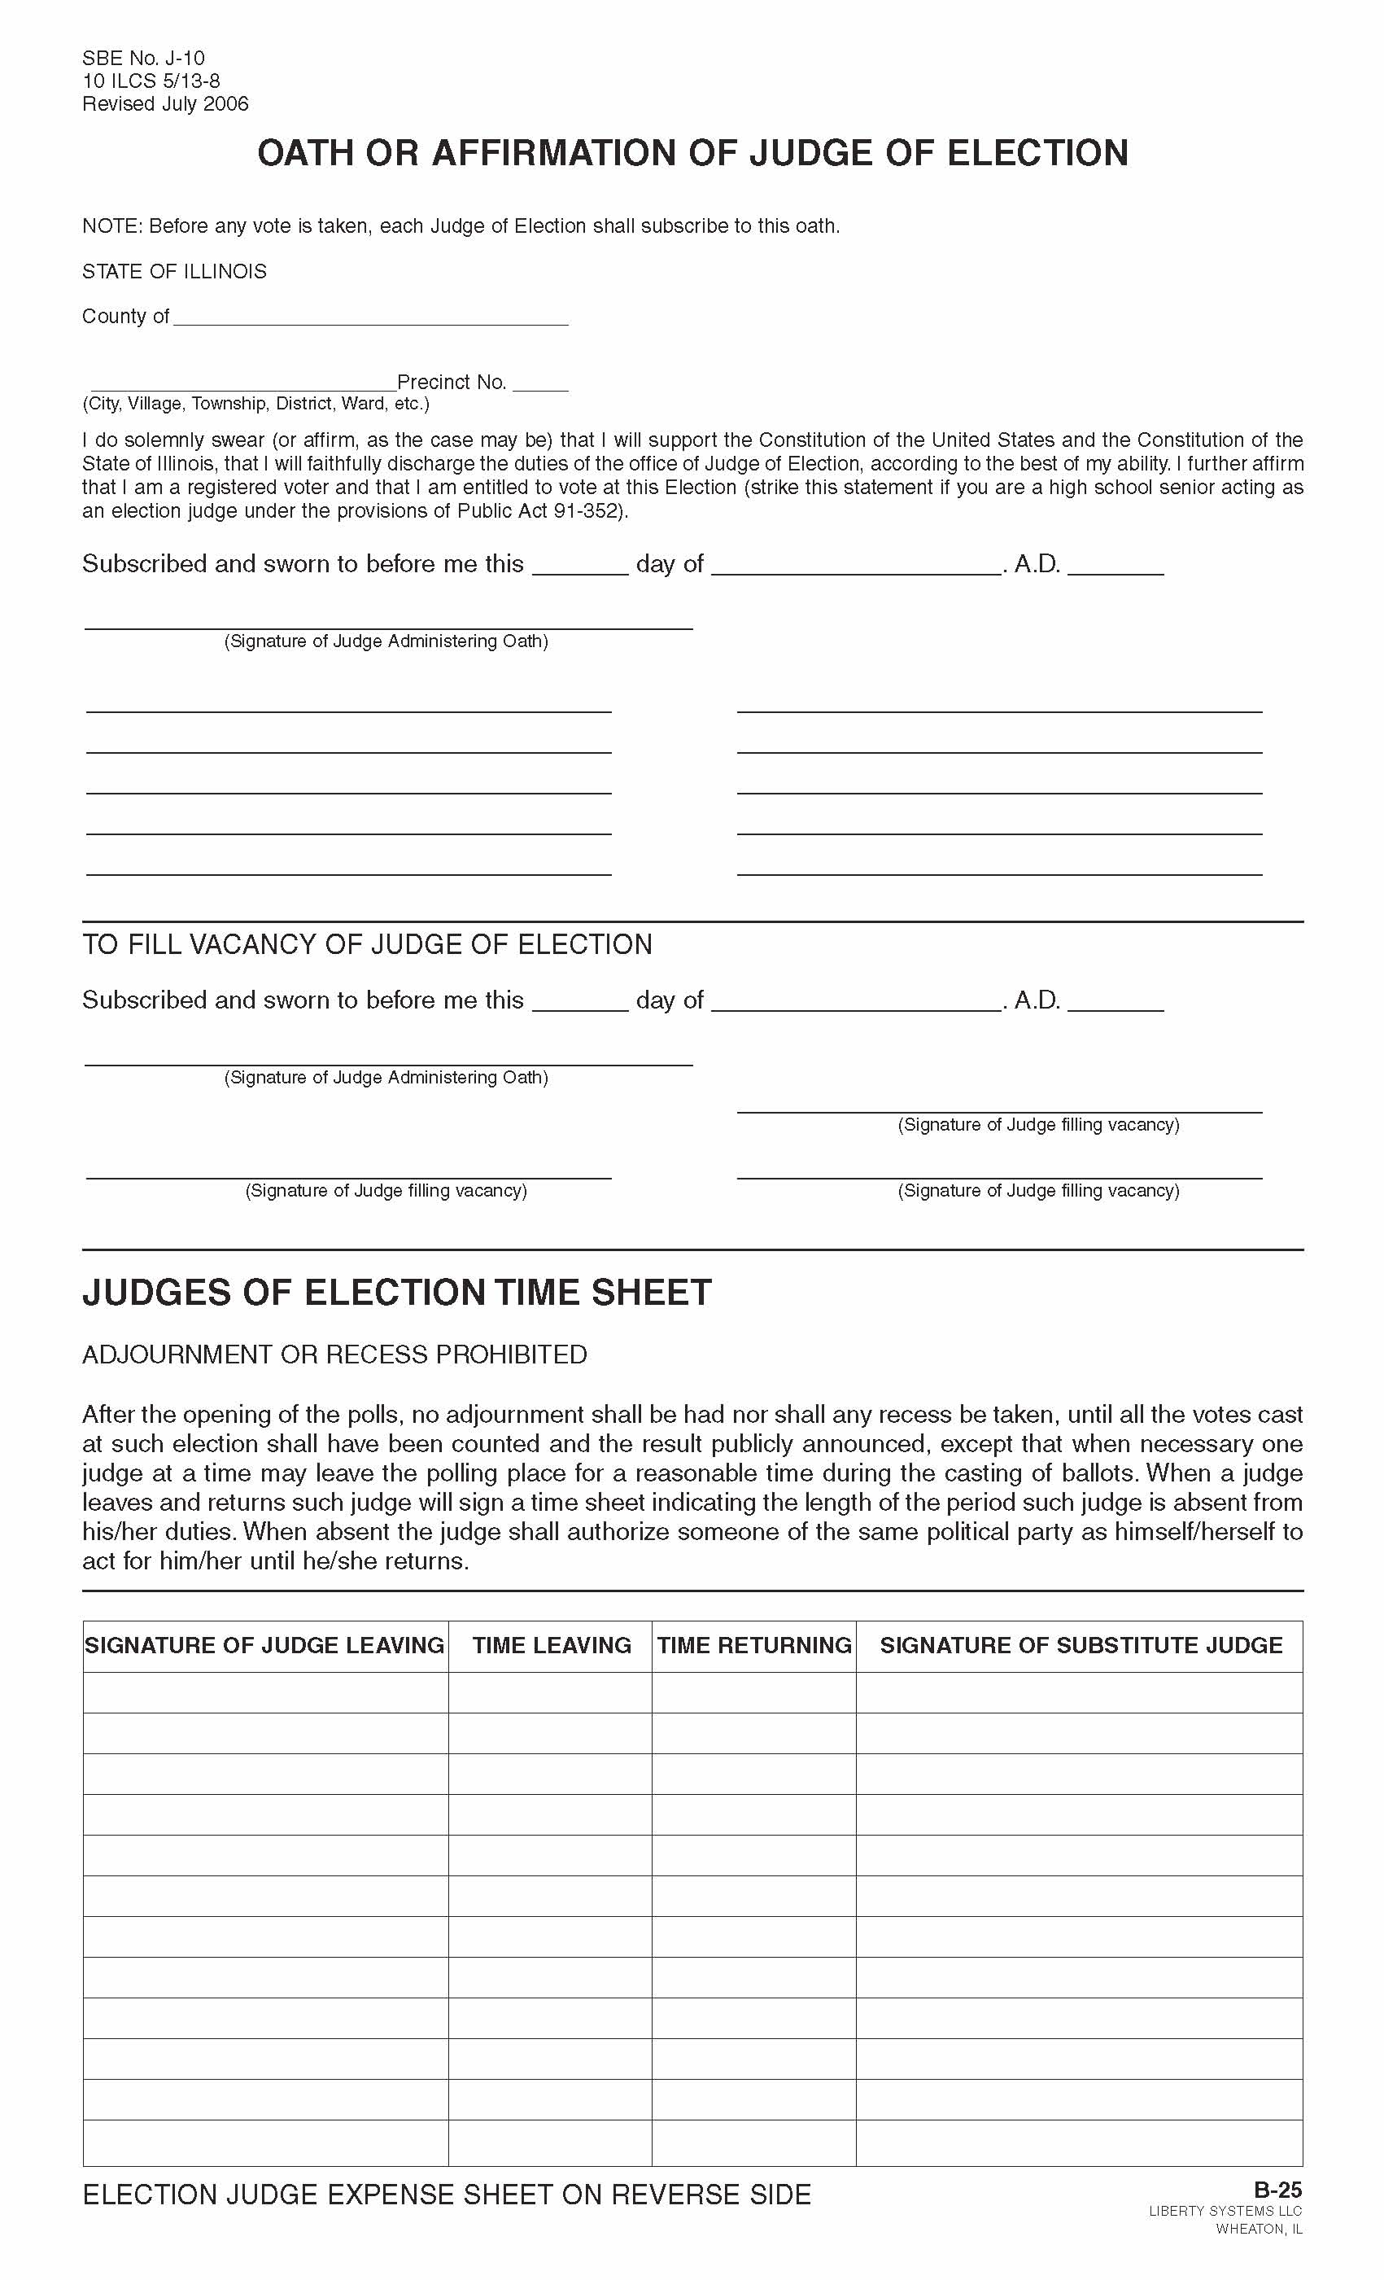
You are Officers of the Circuit Court!
Uphold the U.S. and Illinois Constitutions.
You are the sole authority in the polling place.
You are the sole authority in the Campaign Free Zone.
You are responsible for the proper conduct of the Election
Notes:
Among the supplies you will find the Oath for Judges of Election, which you will administer to each other, and then all sign it. When taking this oath, you swear to uphold the Constitution of the United States and the Constitution of the State of Illinois in performing your duties. (10 ILCS 5/13-8); (10 ILCS 5/13, 5/14)
Election judges should put on a name badge. It should include their name, ward, township or road district, precinct number and the date of the election. (10 ILCS 5/14-5.1)

Slide 7


Remember to…
Rotate positions – it reduces fraud & it’s law
Notes:
Remember to rotate positions. This reduces all appearances of fraud.
Whenever there is a decision to make, a majority of the election judges will make the decisions.
There is NO such thing as a “head judge”. You all have equal authority in the polling place on election day!

Slide 8
Stay Organized!
Match your supplies with the checklist in your supply kit.
If anything is missing, call your election authority.
Notes:
Each supply kit contains a list of all of the supplies you will need on election day. One of the first things you do before setting up the polling place is to check the supply list. Be certain that you have all of the supplies and materials. Usually your supplies are separated by the timeframe you will need them in:
-before the polls open
-during voting hours
-after the polls close
-and also a packet of supplies for provisional voting.
If anything is missing, call your election authority as soon as possible.

Slide 9
Set up voting area
Arrange voting booths for privacy – give the voter as much privacy as possible.
Allow for orderly flow of voter traffic in the polling place.
Reminder: Tabulator(s) must be in full view of election judges!

Slide 10
Make sure the voter is given the correct ballot sheet!
Ballot sheets are designated by code, color, or number.
The ballot sheet code, color, or number should match what is on the voter’s application.
Notes:
Check that the date and the precinct designation on the ballot sheets are correct. If more than one ballot style is being issued in your precinct, be sure that you have the correct ballot styles. The ballot styles may be indicated on the ballot by code, color or number.
Make sure that each voter is given the correct ballot sheet. A voter should only be voting on races for the voting districts in which they live.

Slide 11
Compare each ballot style to each specimen ballot to verify that the following is listed correctly:
Each office
The “vote for” on each office
Each candidate
Then ALL judges sign the
“Certificate of Inspection”
Notes:
When the tabulator is turned on and the zero tape prints, you will need to conduct the same inspection with the zero tape against the specimen ballot.

Slide 12
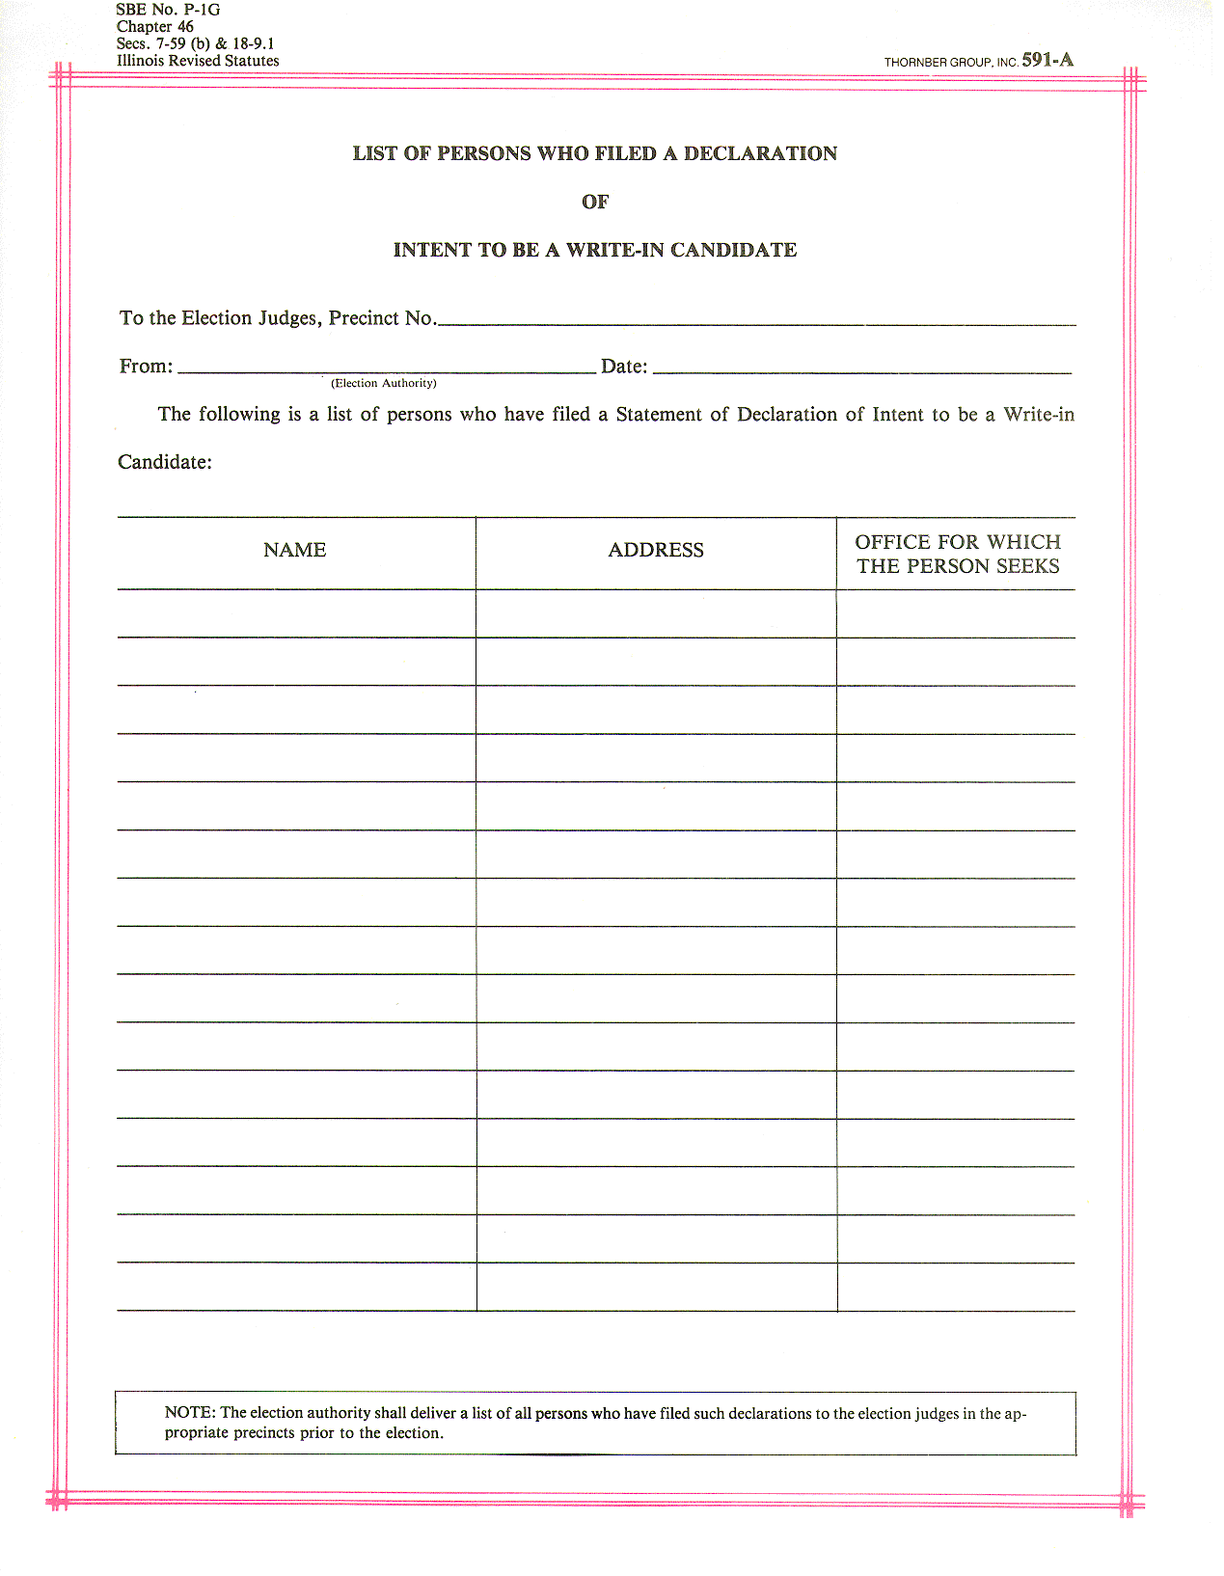
There will only be valid write-in candidates on this list (candidates filing 61 days prior to election day*).
This list should NOT be posted anywhere in the polling place.
Write-in list can be shown to the voter if they have requested to see it.
Valid Write-In Candidates
(list will be provided in your precinct kits)
Notes:
In order for someone to be a valid “write-in candidate”, they must have completed a “Declaration of Intent to be a Write-in Candidate”. This form must be filed with the proper election authority or authorities not later than 61 days prior to the election, which is the ballot certification deadline. The change in this filing deadline allows more room on the ballot. Write-in lines will now only be printed for those offices that have had a candidate submit a declaration of intent to be a write-in candidate. Exception: When an objection to a candidates nominating papers is sustained (thereby creating a vacancy), then write-in votes shall be counted for persons who have filed a notarized declaration of intent for that office not later than 7 days prior to the election. In those cases, the election authority will have lines printed on the ballots for races that have objections pending at the time of ordering the ballots. (10 ILCS 5/17-16.1); (10 ILCS 5/18-9.1)
If a write-in candidate is running in a district that goes into more than one election jurisdiction, the candidate must file this form in every election jurisdiction in which he/she would like to have their write-in votes counted.

Slide 13
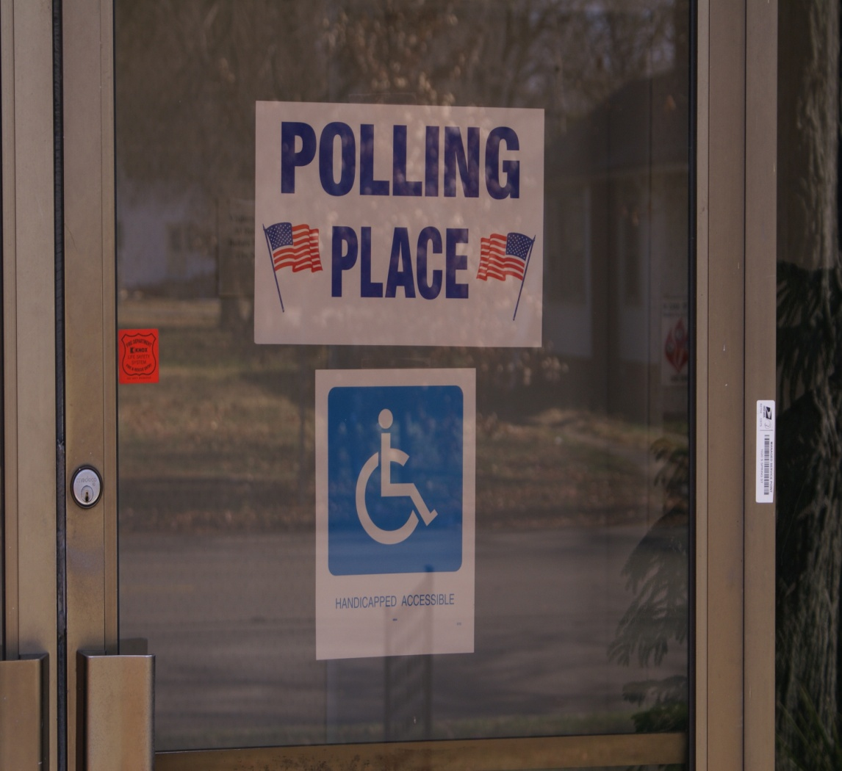
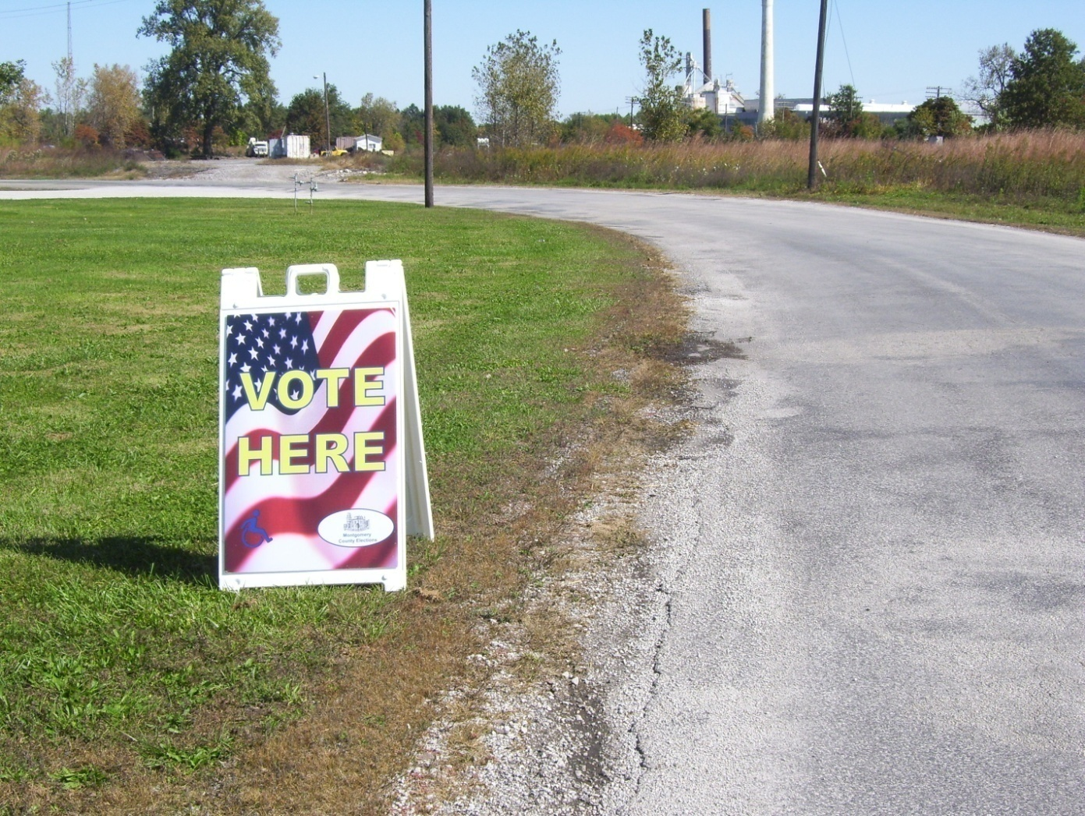
Polling Place Entrance Sign & ADA Compliant Sign
Public Roadway Polling Place Sign
Should clearly identify the entrance
ADA sign may not be on the main entrance used by most voters
Should be placed on the public roadway nearest to the entrance of the polling place
Must clearly identify polling place
Notes:
-Promptly at 6:00 am unlock the doors, and announce that the polls are open.
-If any judges are missing, try to contact the missing judge. If you can’t reach the missing judges, call the election authority’s office. If the election authority cannot provide a replacement judge, the other judges may appoint a replacement. Replacement judges cannot be appointed until after 6:15 am.
-Collect pollwatcher credentials as soon as a pollwatcher enters the polling place. These credentials are not returned to the pollwatcher, but rather are turned in with all your other supplies at the end of the day to the election authority.
-ADA signage, 26 Ill. Adm. Code 209.30

Slide 14
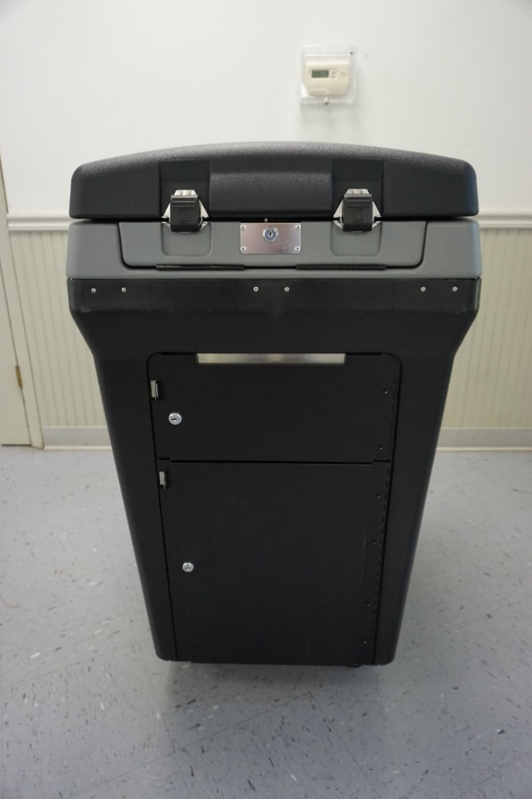
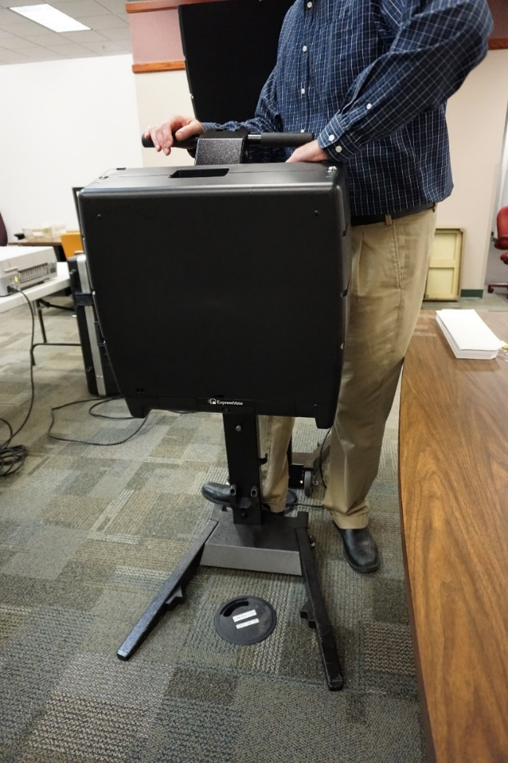
Two Forms of Equipment
DS200 & Express Vote
Notes:
Ask if there are any new election judges: if they want more prep, call County Clerk’s office to set up a time to come in and get more hands on training with the machine.
Federal law requires every polling place to have voting equipment available for voters with disabilities.

Slide 15
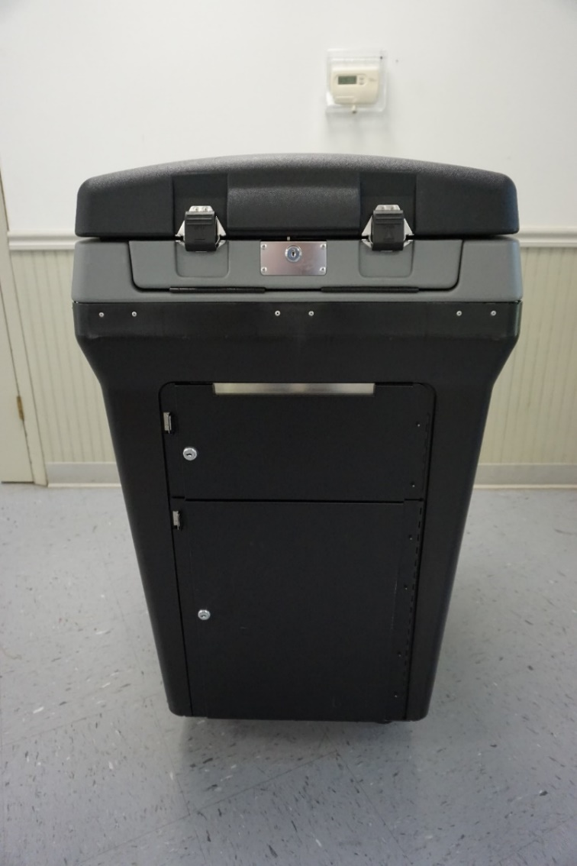
DS200 Preparation

Slide 16
Instructions will be provided to you!

Slide 17
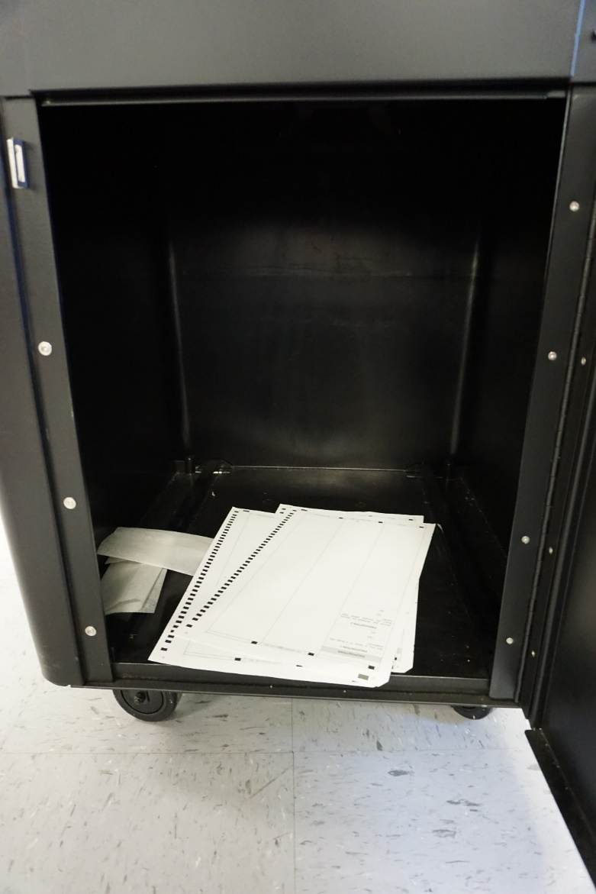

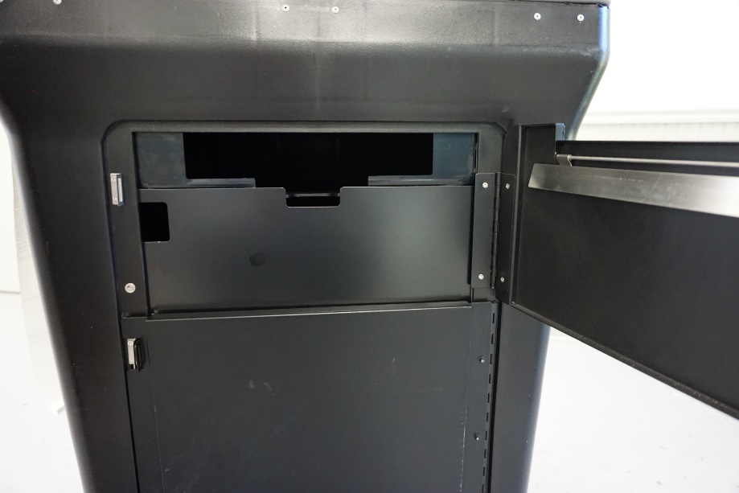
Verify that all compartments of the ballot box are empty.
Notes:
Including where the ballots drop in from the tabulator and the auxiliary bin compartment (located on the side of the ballot box).
Also make sure that it is clean – there is not water or anything in the box that could potentially damage the ballots.

Slide 18
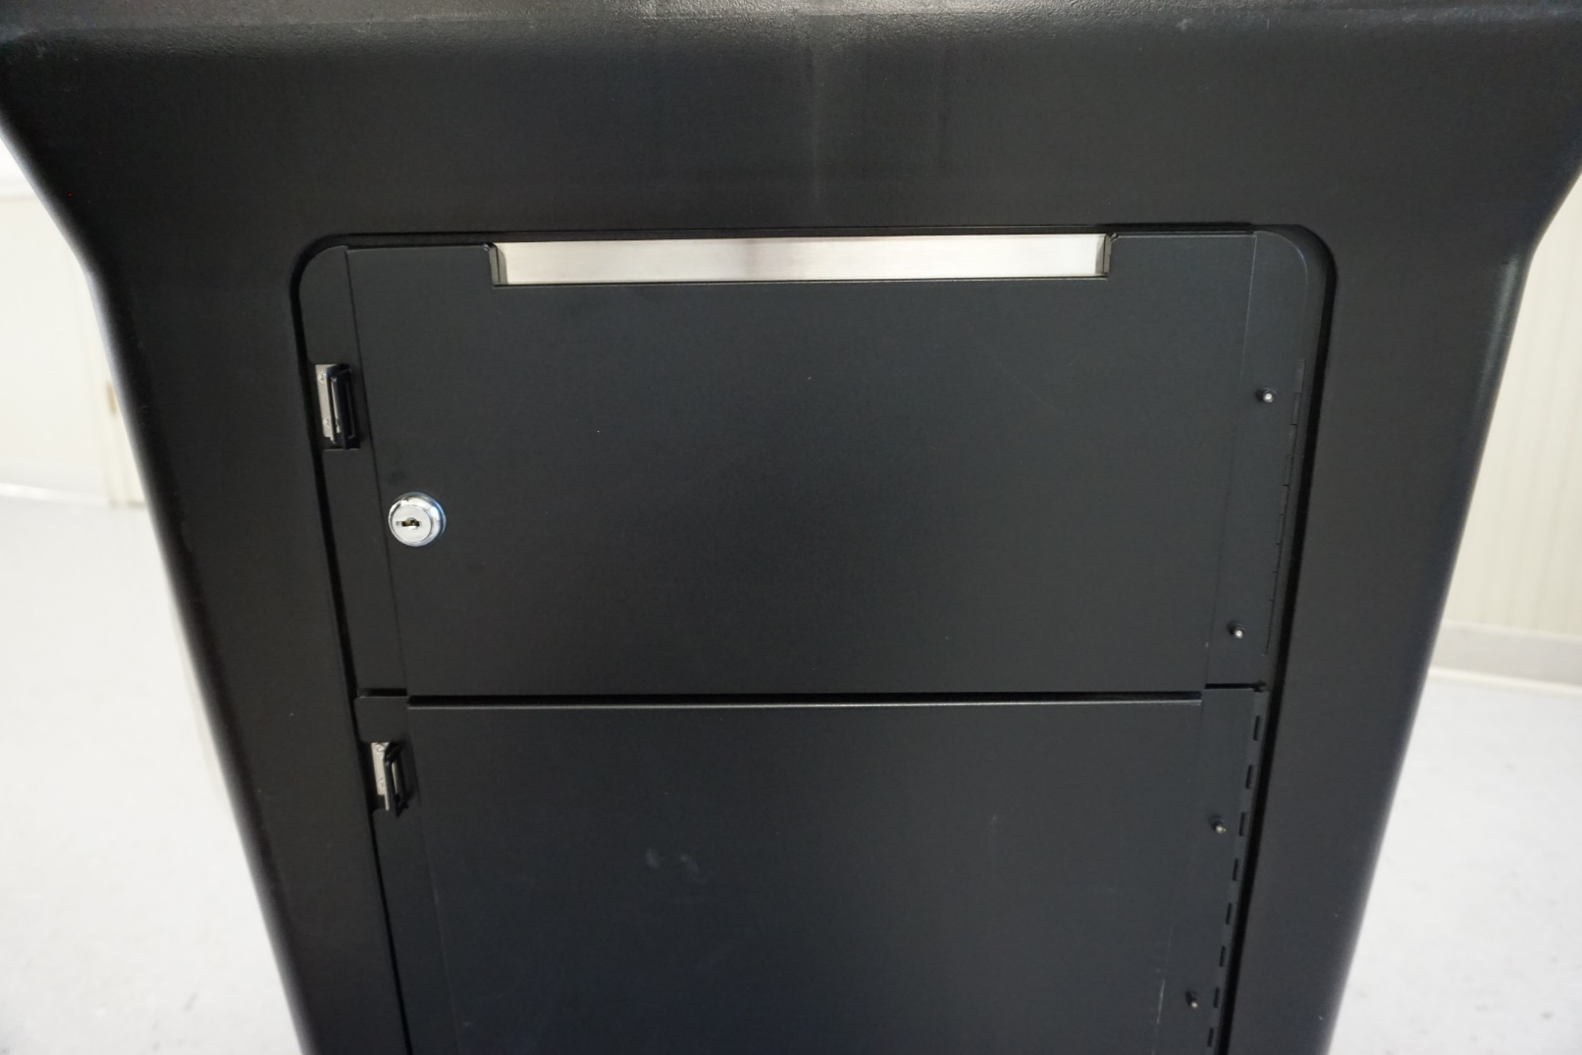
Close and lock all compartments!
All compartments should remain locked until after 7:00 p.m.

Slide 19
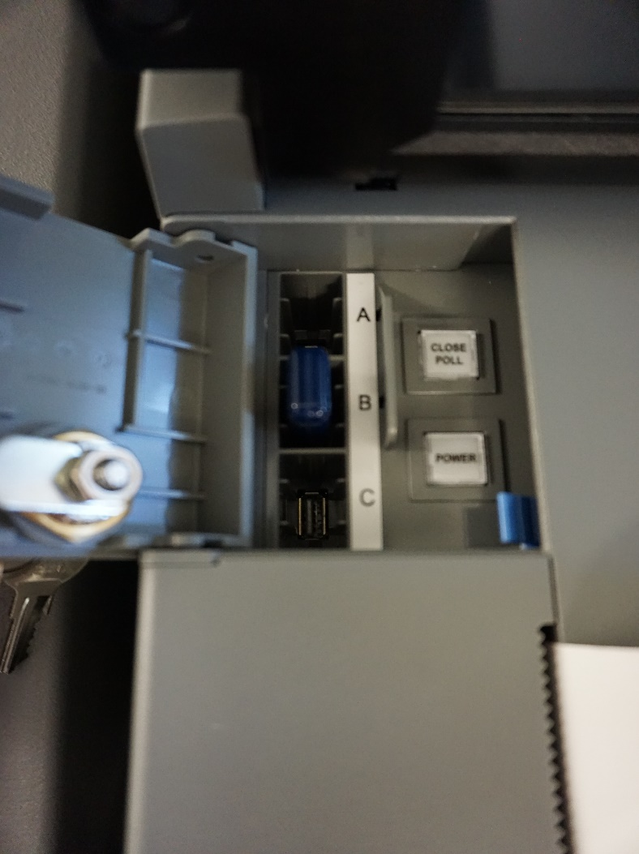
Memory Stick
Verify that the memory stick is inside.

Slide 20
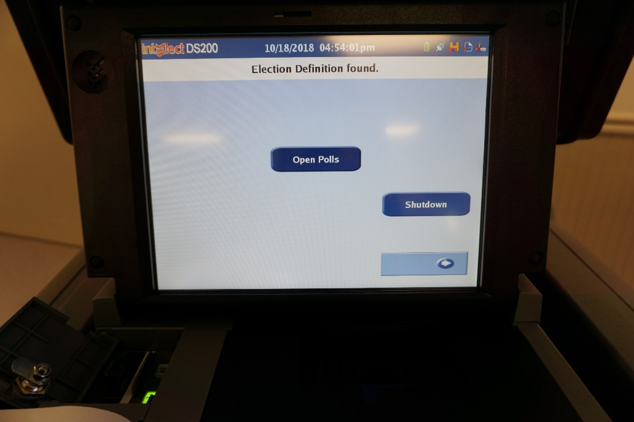
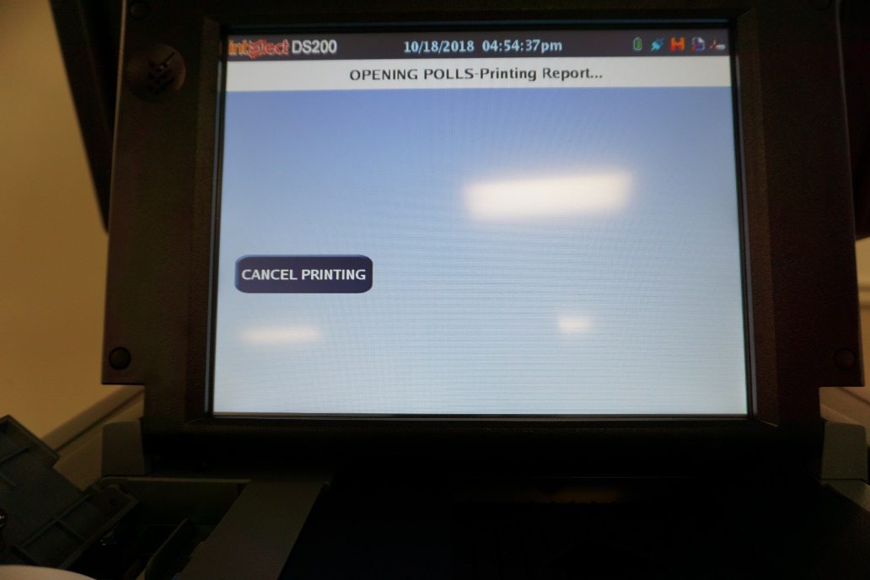
Type in election code
Press “Open Polls”
Print zero report

Slide 21
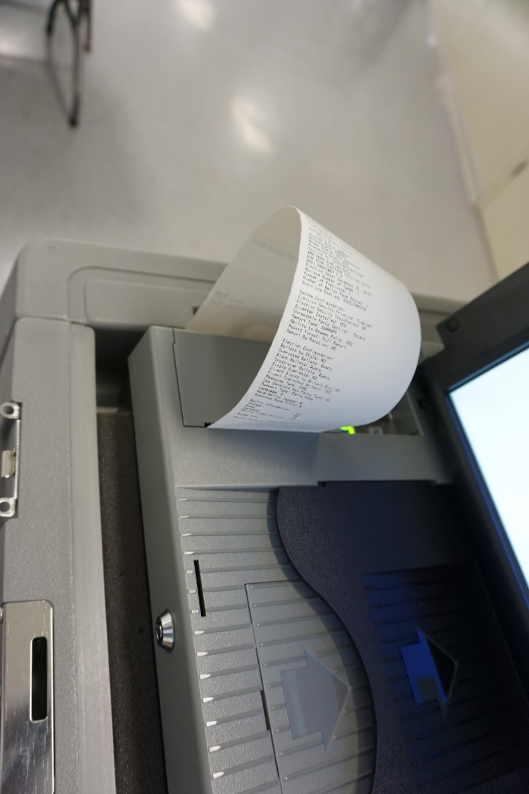
Zero Tape
Check Date and Time on Tape
Verify that the zero tape has no votes cast.
Check for correct precinct name and number.
Compare the tape to the specimen ballot.
Each judge must sign the zero tape.

Slide 22
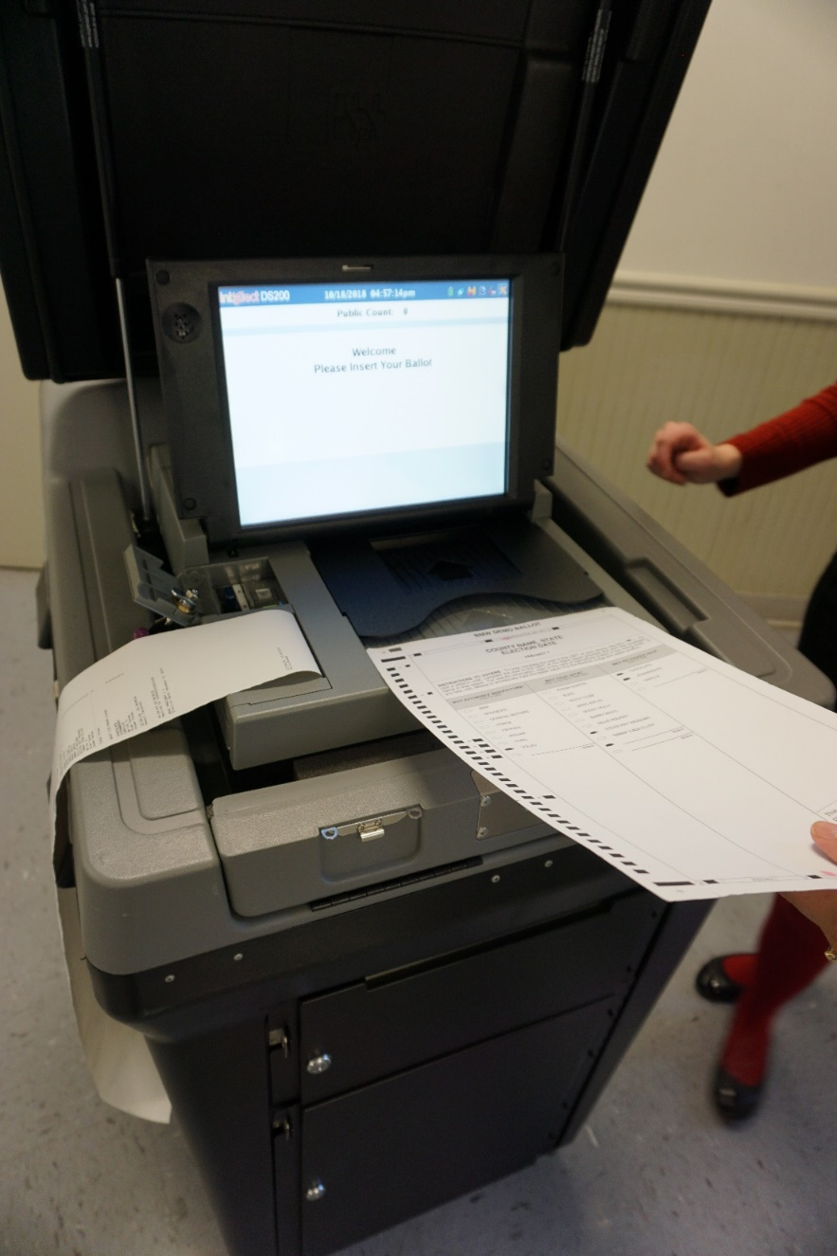

The DS200 is Ready!

Slide 23

Express Vote Preparation

Slide 24
Instructions will be provided to you!

Slide 25
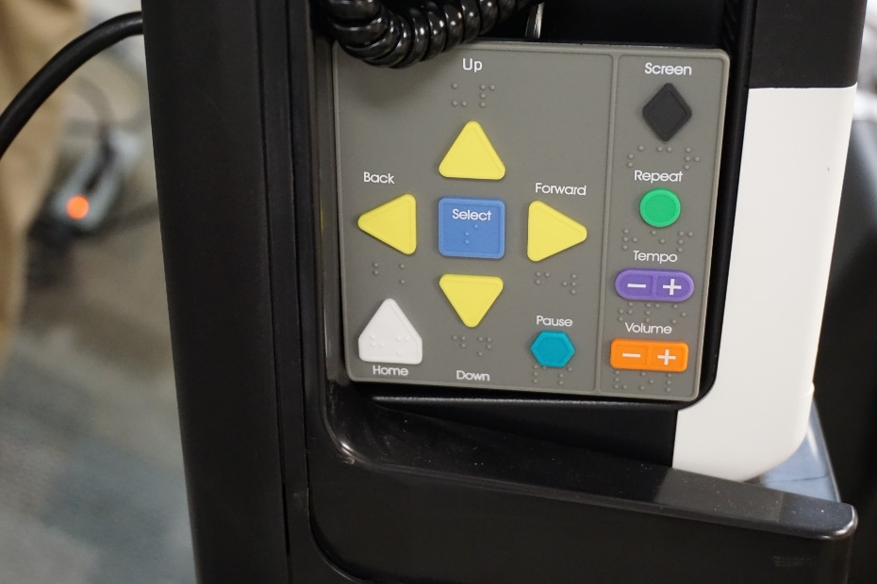
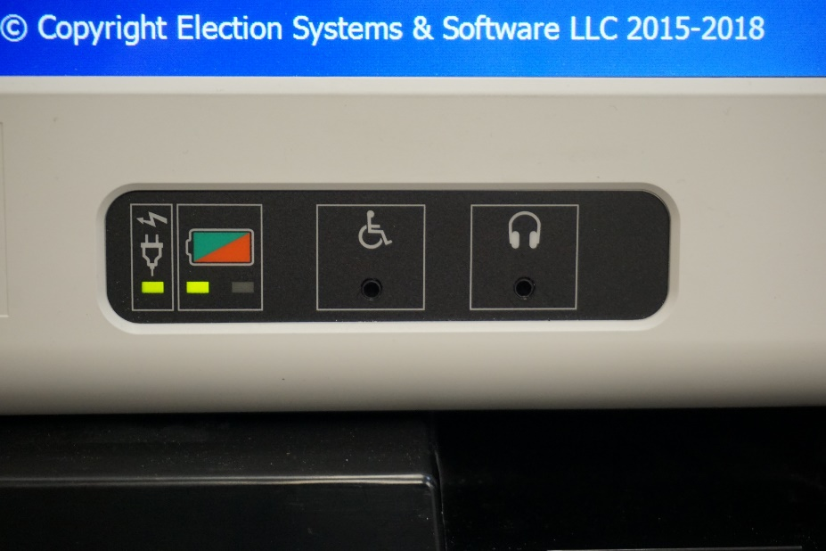
Accessibility Features
Keypad with Braille
Headphones
Notes:
The headphones should be plugged into the jack located on the front lower right hand corner of the machine.

Slide 26
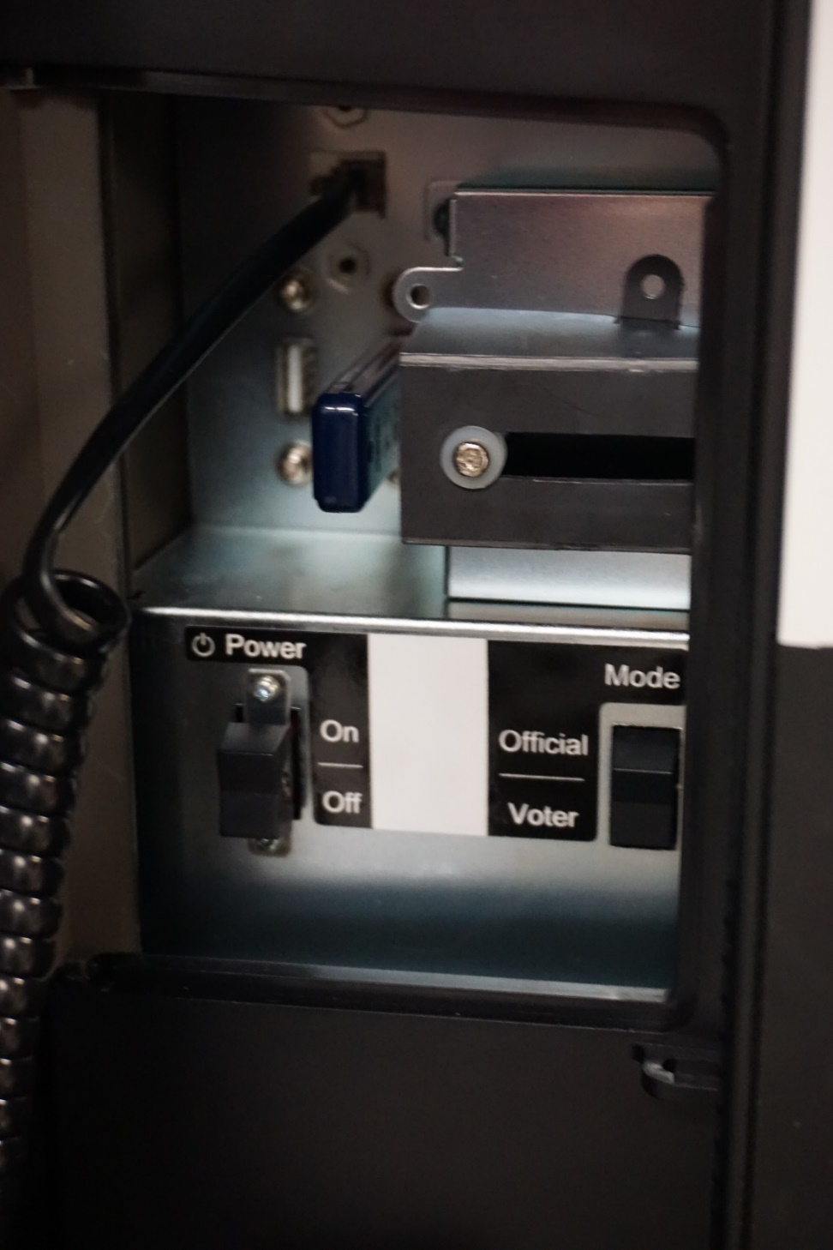
Unlock power compartment
Turn machine on
Verify memory stick is in the machine
Make sure the machine is in “voter” mode
Lock compartment up securely

Slide 27
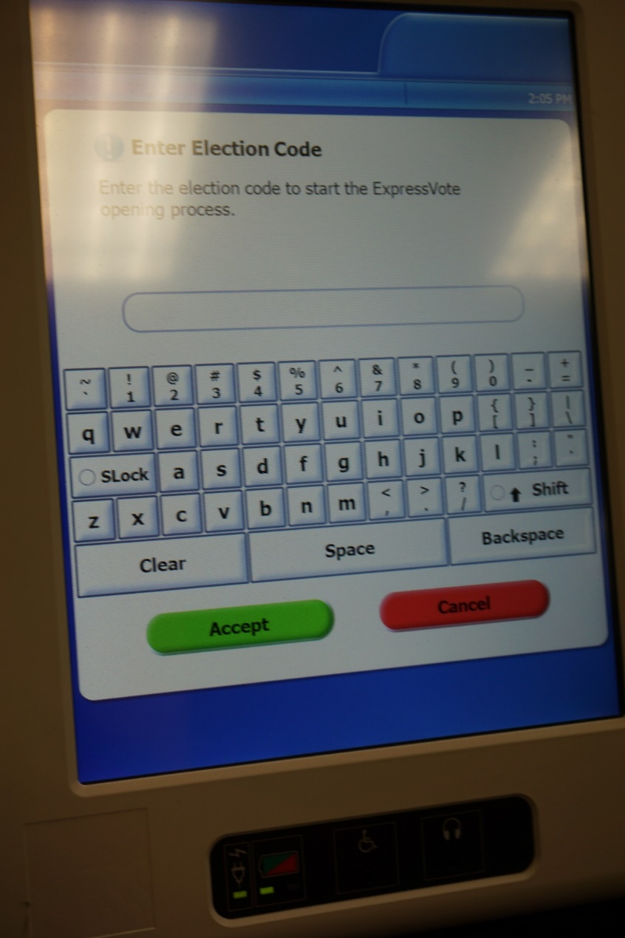
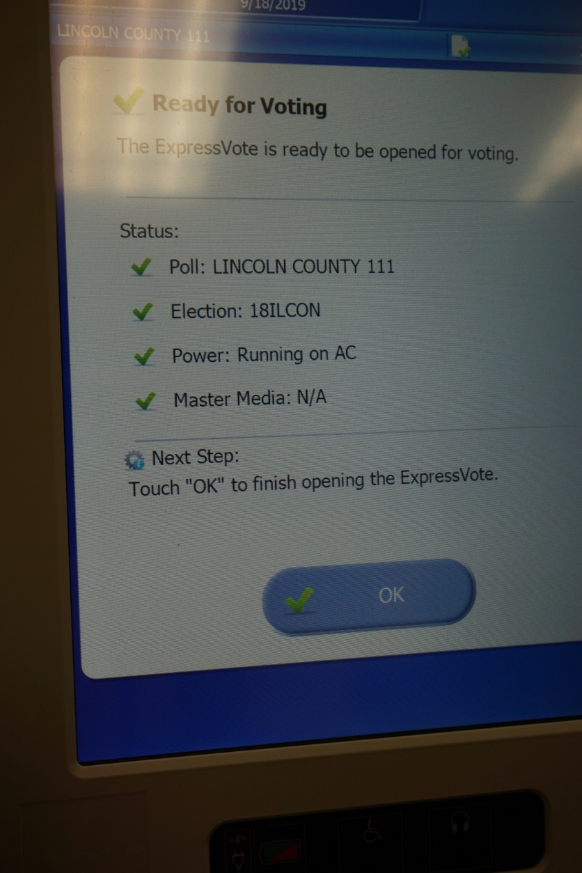
Press “ok” after the machine is finished setting up
Enter election code

Slide 28
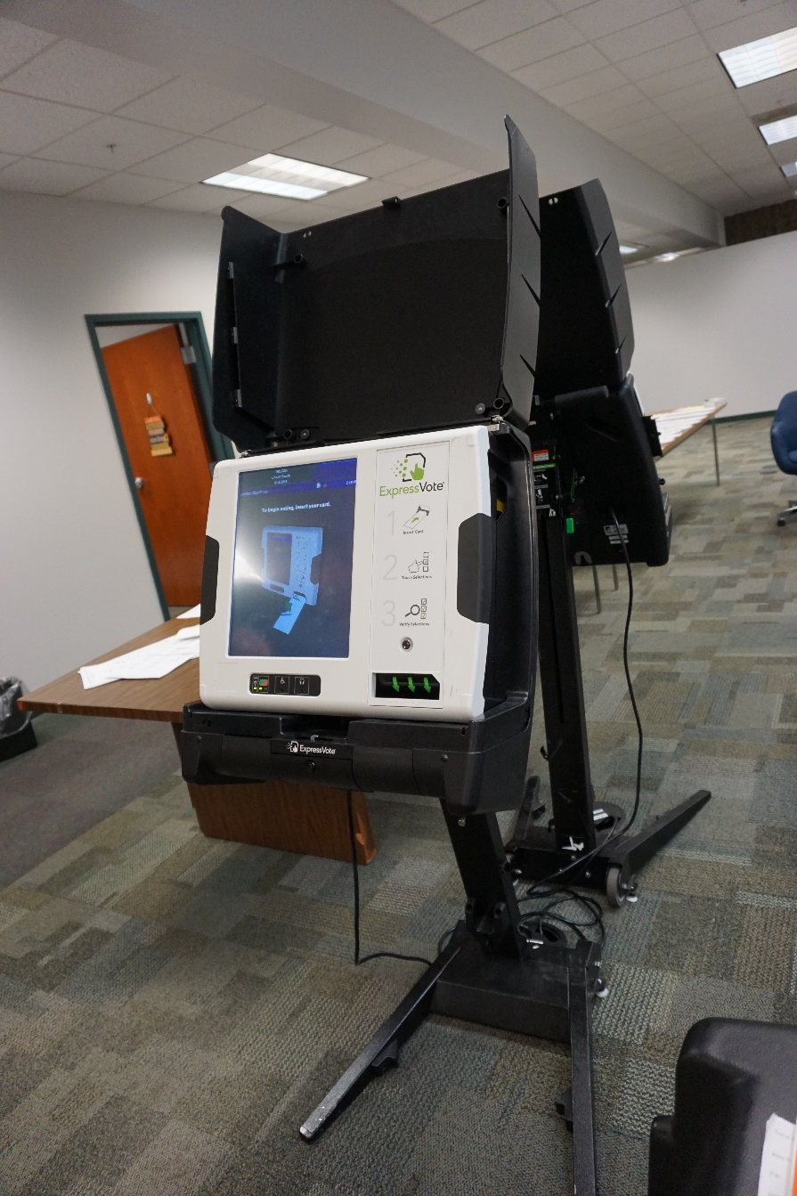
The Express Vote is Ready!

Slide 29
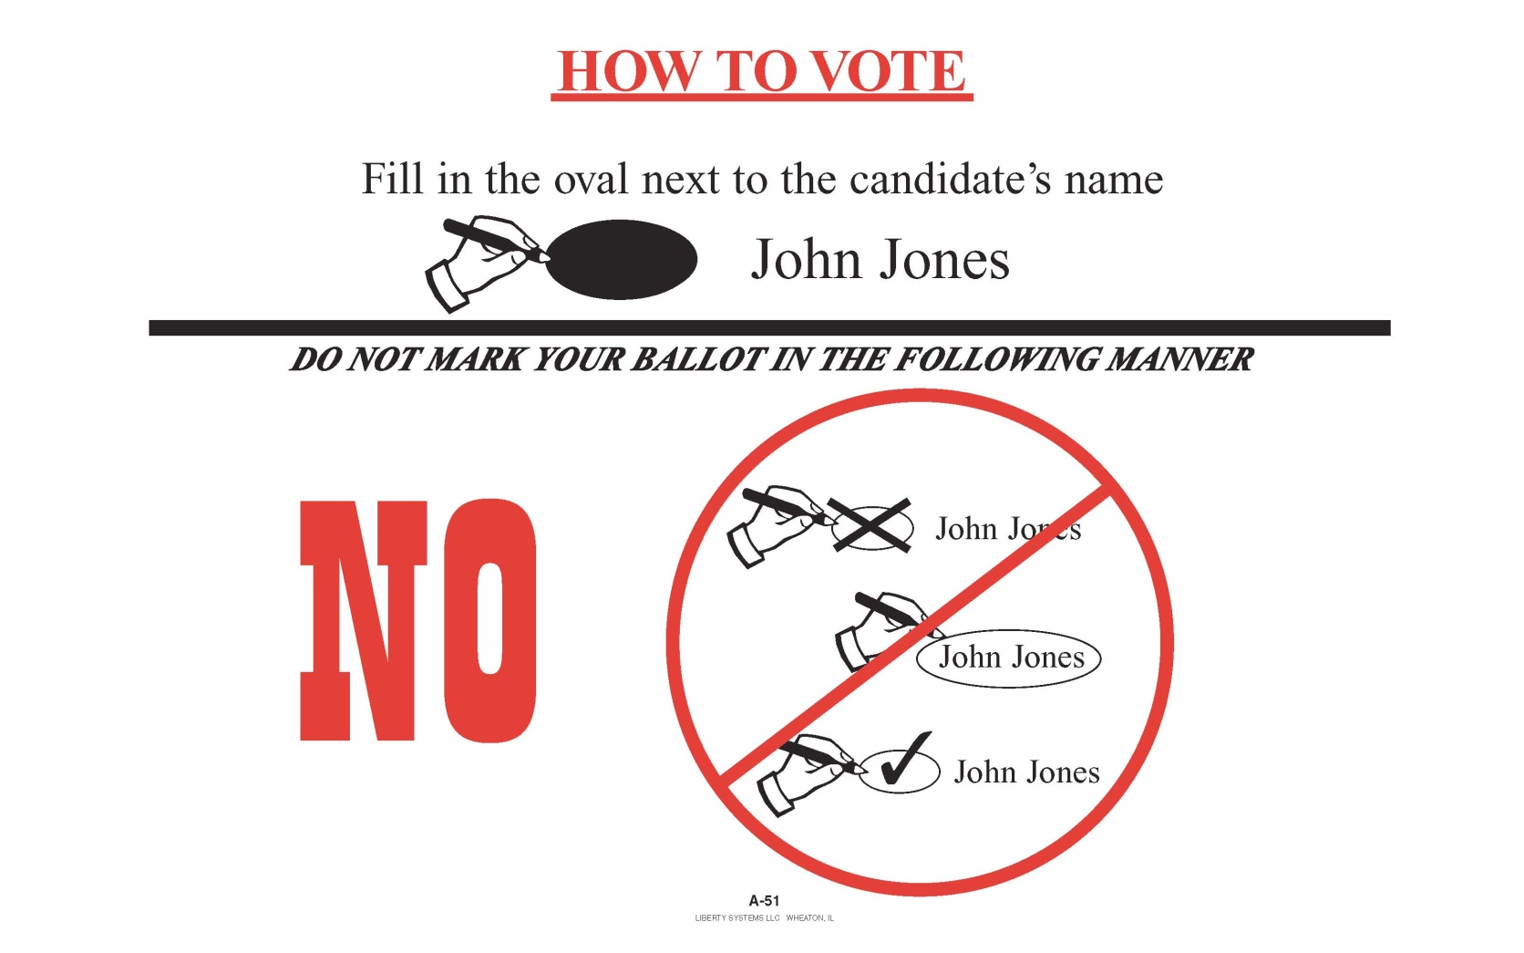
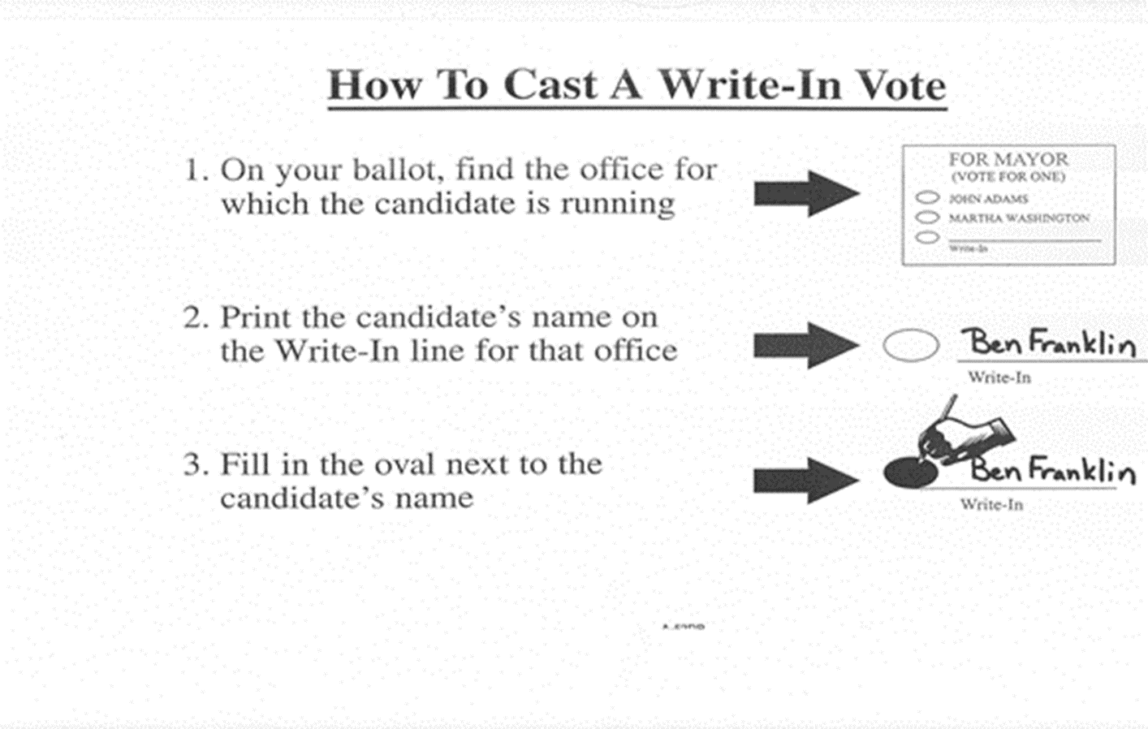
Post Instructions in Voting Booths and around Polling Place!
Notes:
Post the voting instruction cards in and around the polling place. Voting instruction cards on how to “darken the oval” and “how to cast a write-in vote” should be placed in each booth. (10 ILCS 5/11-4.3)

Slide 30
Law Enforcement Officials
Representatives of:
  Attorney General
  State’s Attorney
  Election Authority
  State Board of Elections
Qualified Pollwatchers (with proper credentials)
Who else may be present in the polls on Election Day?
Notes:
Other than the pollwatchers, who else may be present at the polls on Election Day?
Law enforcement officers on official duty, and representatives of the State Board of Elections, the office’s of the State’s Attorney/Attorney General, and representatives of the Election Authority should be permitted to remain in the polling place with the election judges throughout the day. They may be there before the polls open, during voting hours, or after the polls close. (10 ILCS 5/7-34)
Pollwatchers are the only ones that must provide written pollwatcher credentials to the election judges at the polls on Election Day. Everyone on this list is only required to show their official credentials or other identification to the judges of election as they enter the polling place.

Slide 31
Pollwatcher Qualifications
Registered voter in Illinois
Must have credentials issued by the State Board of Elections or Election Authority
Are appointed by: Candidates, political parties, qualified civic organizations, state civic organizations, or are proponents and opponents to a proposition
Must have separate credentials for each precinct they enter, even if there are two precincts in one polling place!
Candidates CAN be pollwatchers
Notes:
To be a qualified pollwatcher, a person just has to be a registered voter in Illinois. (10 ILCS 5/7-34)
A pollwatcher must have a credential issued by the election authority or SBE, and also signed by the appointing authority.
There are many organizations and groups that can appoint pollwatchers.
Pollwatchers must have a separate credential for each precinct they enter.

Slide 32
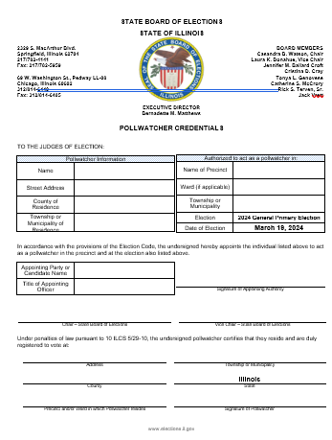
Pollwatcher Credentials
Collect when they first enter polling place – YOU keep
Use sign in/sign out sheet when coming and going
Return credentials to election authority
Notes:
Pollwatchers must present valid credentials to the election judges as soon as they enter the polling place. Once a pollwatcher has surrendered his/her credential, he or she may come and go throughout the day unless such activity is disruptive. (10 ILCS 5/7-34)
All pollwatcher credentials must be returned to the election authority with all other materials at the end of the night. Some jurisdictions have a separate envelope for the pollwatcher credentials. This envelope is also used as a sign-in and sign-out sheet.

Slide 33
Pollwatcher Rights
May observe all proceedings and records relating to the conduct of the election, but cannot touch or handle any of the material.
May come and go throughout the day as long as their behavior is not disruptive.
May call attention to incorrect procedure.
May challenge the qualifications of a voter.
Reminder: The secrecy of the ballot must be maintained.
Notes:
Pollwatchers may view any and everything in the polling place on election day…except how a person is voting their ballot. Pollwatchers are not allowed to touch any of the documents and materials. (10 ILCS 5/7-34); (10 ILCS 5/24-8); (10 ILCS 5/24A-8); (10 ILCS 5/24A-13); (10 ILCS 5/24B-8); (10 ILCS 5/24B-13); (10 ILCS 5/24C-8)

Slide 34
Campaign Free Zone
100 horizontal feet from the ENTRANCE to the polling place/room
No campaign buttons
No electioneering
No campaign signs
You are the sole authority of the
Campaign Free Zone!
Notes:
A campaign free zone is that area in which no advertising pertaining to any candidate or proposition to be voted upon shall be displayed. No one is permitted to wear a campaign button, display political literature, or engage in any political discussion within the restricted area. The campaign free zone is made up of the polling room and the distance within 100 horizontal feet of any such room. Any person who violates this section may be punished for contempt of court. (10 ILCS 5/7-41)
Electioneering is defined as working for, or in the interest of a candidate, party or proposition.

Slide 35
During Voting Hours:

Slide 36
At 6:00 A.M…
Announce out loud “Polls are Open!”
Unlock the door
Replace missing judges if approved by EA
Collect any pollwatcher credentials
Notes:
-Promptly at 6:00 am unlock the doors, and announce that the polls are open. (10 ILCS 5/17-2)
-If any judges are missing, try to contact the missing judge. If you can’t reach the missing judges, call the election authority’s office. If the election authority cannot provide a replacement judge, the other judges may appoint a replacement. Replacement judges cannot be appointed until after 6:15 am.
-Collect pollwatcher credentials as soon as a pollwatcher enters the polling place. These credentials are not returned to the pollwatcher, but rather are turned in with all your other supplies at the end of the day to the election authority.

Slide 37
A list will be provided for Early, Vote by Mail, and Grace Period Voters.
A voter cannot revoke or cancel a ballot that has already been voted!
If a voter is marked as already voted and claims they have not, call the Election Authority’s office!
If a voter was issued a Vote by Mail ballot, has not voted it, and surrenders the ballot to you on election day, he/she may vote as normal.
If a voter claims he/she never received their Vote by Mail ballot, he/she may sign an affidavit and vote on election day.
Notes:
A list will be provided by your election authority of everyone that has requested a Vote by Mail, Early or Grace Period Ballot. These ballots will be processed at a central location specified by the election authority.

Slide 38
Voters may be challenged by Pollwatchers, Election Judges, or another voter.
Reasons for the challenge:
Voter has moved
Voter has already voted
Voter has changed name
No record of registration
Not the same person as registered voter
Notes:
A voter may be challenged on their qualifications to vote by an Election Judge, a Pollwatcher, or any person that is legally allowed to be in that polling place.

Slide 39
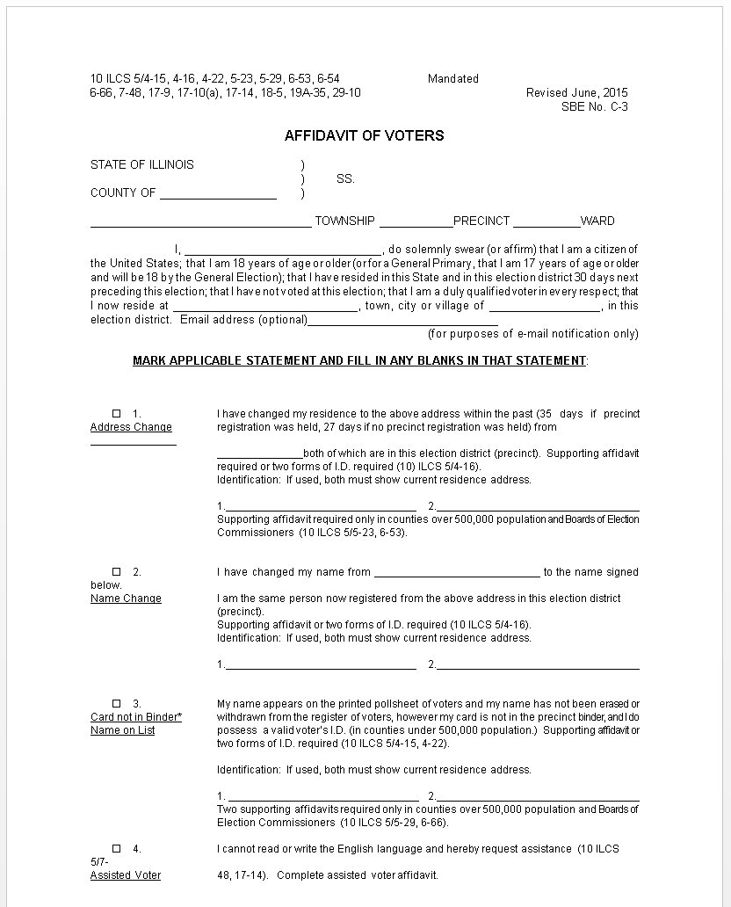
Voter Affidavit
Change of Residence
Name change (same precinct)
Name on list, no digitized signature to compare
Vote by Mail ballot not received
Notes:
There are many kinds of affidavits used in the polls on Election Day. It is a good idea to review these affidavits so that you are familiar with them when you need to use them. This is especially important for newly appointed election judges. (10 ILCS 5/17-9); (10 ILCS 5/17-10); (10 ILCS 5/17-14); (10 ILCS 5/18-5)

Slide 40
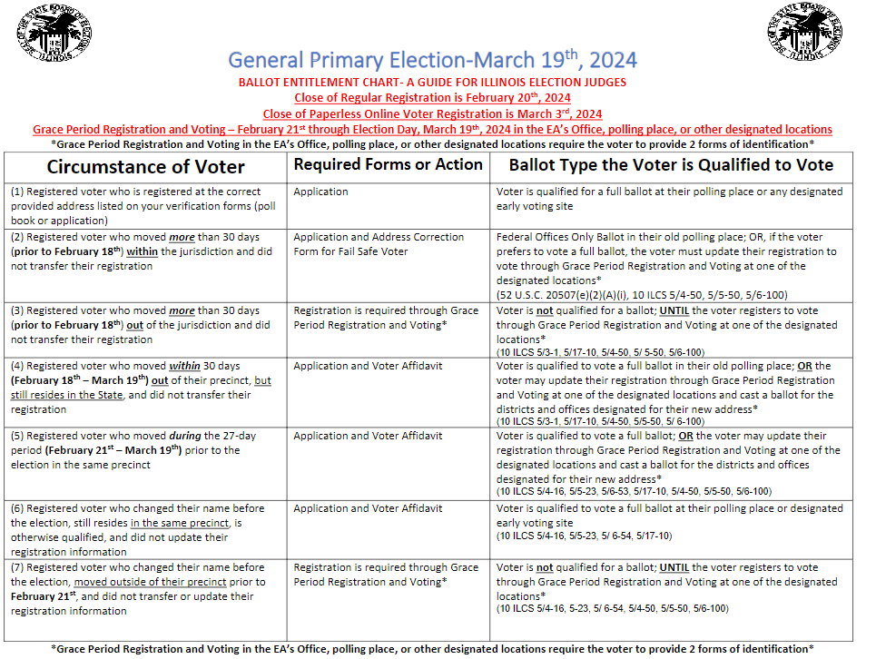
Ballot Entitlement Chart
Notes:
This chart will be with your precinct kits.
Leave this chart out on your table on Election Day to help with different situations that may occur, and how to handle those situations.

Slide 41
What if…
Voter’s registration cannot be found
Voter is challenged by a pollwatcher
Voter insists he or she is eligible to vote
Voter applied for registration at drivers license facility or on-line
Contact your Election Authority’s office for additional information and instruction!
Notes:
Always call the election authority’s office if you have any questions. Keep in mind that you only have the information in your precinct….for your precinct. But the election authority has the information for the entire jurisdiction.
If a voter states that they applied for registration at the drivers license facility, and don’t have their receipt with them….ALWAYS contact your election authority. Each election authority is contacted by the SBE and the Illinois Secretary of State before each election and provided election day hotline numbers. The election authority has the ability to verify this information through the secretary of States office ON election day.

Slide 42
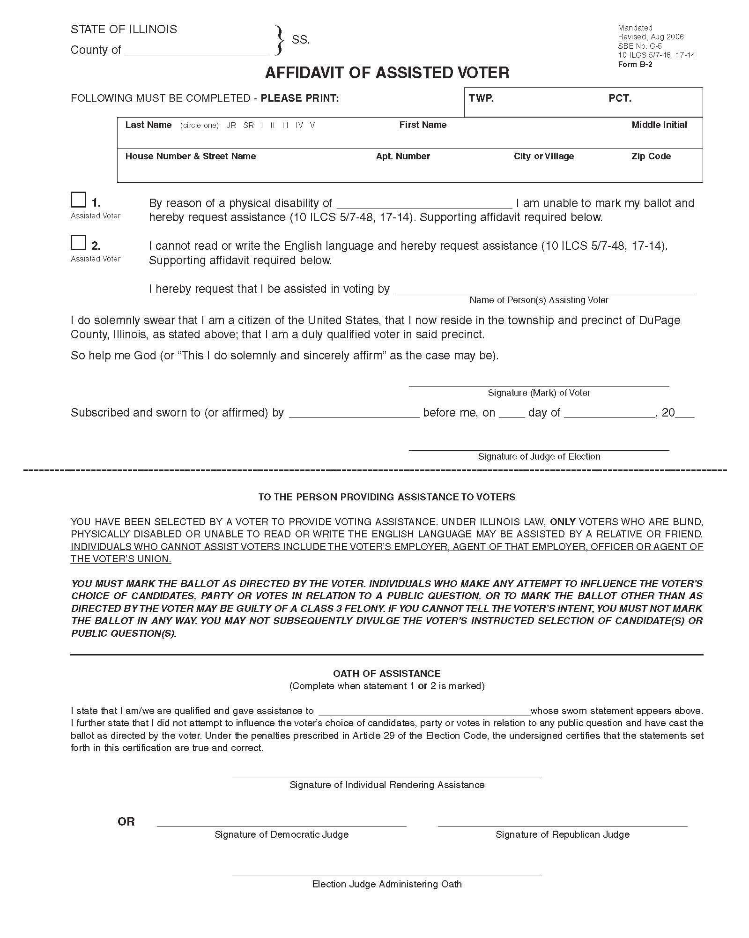
Voter Assistance: for Voters with Disabilities or Voters who can’t Read or Write the English Language.
Affidavit of Assisted Voter must be filled out every time a voter receives assistance in the voting booth!
This affidavit must be spindled along with the voters application.
Notes:
Remember that any voter receiving assistance at the polls on election day must fill out this “assisted voter affidavit”. (10 ILCS 5/7-48); (10 ILCS 5/17-14)

Slide 43
Intoxicated voters cannot receive assistance in the voting booths!
Notes:
Intoxication is not regarded as a physical disability, and no intoxicated person shall be entitled to assistance in marking this or her ballot.
If you DO assist an intoxicated person in marking their ballot, you could be accused of influencing someone that is already under the influence!

Slide 44
Who can and can’t give assistance?
Who can give Assistance?
Who can’t give assistance?
Friend
Relative
Two Election Judges (one from each political party)
Voter’s employer
Agent of the voter’s employer
Officer of the voter’s union
Agent of the voter’s union
Remember: Fill out Affidavit!
Notes:
(10 ILCS 5/17-14)

Slide 45
Judge’s Station #1 – Application Judge
Voter states his or her name and address – verify it matches your records
Verify voter has not already voted – check your list!
Complete application
Notes:
Station One: The applications to vote, the affidavits, demonstrator ballot sheets, and a number of pens should be placed at this station.
-As each voter comes into the polling place, first ask them to state their name and address. You will be provided a list of all registered voters names and addresses for your precinct.
-Verify voter has not already voted by checking the “Vote by Mail, Early and Grace Period Voters” list.
-If the election is a primary, the voter must declare his/her party affiliation and then be given the ballot application of that party.
-An application to vote must be completed by each voter. Make sure that the voter’s name is printed on the application. Some jurisdictions use pre-printed applications.

Slide 46
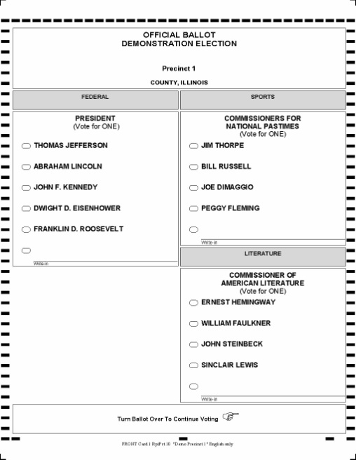
(cont.) Judge’s Station #1 – Application Judge
Offer voter instructions on Demonstrator Ballot Sheet and remind voter to turn the ballot over to vote for issues on the back (if applicable).
Announce voter’s name and address out loud.
Pass the application to the verification judges at station #2.
Notes:
Offer each voter a demonstration on how to properly vote the ballot. Using a demonstrator ballot sheet, allow each voter to “Darken the Oval”. Be sure to remind the voter to “turn the ballot over” to vote on issues on the back side of the ballot (if that applies).
-Announce the voter’s name. In a loud clear voice, announce the voter’s name and address, and if it is a primary election, announce the voter’s party affiliation.
-Pass completed application to the verification judges at Station Two.

Slide 47
Judge’s Station #2 – Verification Judges
Two Judges of Opposite Parties
Locate voter’s verification record
Compare/verify signature and address on the application matches the voter’s record
Determine the correct ballot style
Initial the application
Notes:
Station Two: The scanned signatures, binder books, electronic pollbooks, and a listing of the different ballot styles should be placed at this station.
-Two judges, one from each political party must be at this verification station at all times.
-Compare/verify signature and address on the application matches the voter’s record.
-Using the records provided by the election authority, determine the correct ballot style the voter is to receive. Indicate the ballot style on the application, if it is not already printed on it.
-One judge will initial the application and will return it to the voter.

Slide 48
Judge’s Station #3 – Ballot Distribution
Check application for judge’s initials and ballot style
Spindle applications and number consecutively
Determine/locate correct ballot sheet
Notes:
Station Three: The spindles for the applications and the ballots should be placed at this station.
-Check that the application is initialed by one of the verification judges and has the ballot style listed on it.
-The judge should then place the application on the correct spindle, and number it consecutively with the others on the same spindle. Some jurisdictions have the applications of each ballot style spindled separately (this varies between jurisdictions).
-Determine and locate the correct ballot sheet for each voter.

Slide 49
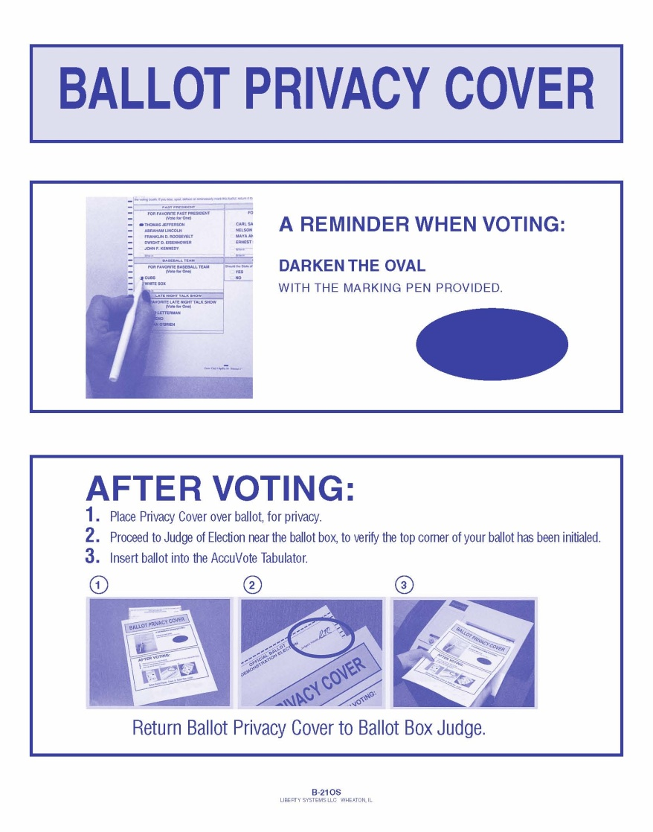
(cont.) Judge’s Station #3 – Ballot Distribution
Initial ballot sheet
Provide voter with correct ballot style
OFFER secrecy sleeve and instruction reminders on voting and use of sleeve
Direct voter to voting booth
Notes:
-Using a pen (in some cases RED ink), properly initial the ballot sheet for each voter. Do not initial ballots in advance. After the judge initials the ballot sheet, they should provide the voter with the ballot and secrecy sleeve.
-Direct the voter to a voting booth.
-If it was determined at the first station that the voter is only eligible for a provisional ballot, contact the election authority to determine this provisional voter’s correct precinct. A provisional voter will use the same ballots as all the other voters. The difference is…the provisional voter will NOT insert their ballot in the tabulator. The provisional voter will place their ballot in the provisional ballot envelope. This envelope will be sealed and returned to the election authority after the polls close.
-If the voter makes an error in marking their ballot, or otherwise spoils their ballot, he/she may be issued another ballot. Mark the original ballot sheet “Spoiled” and insert it into the “Before 7:00 p.m. envelope” for spoiled ballots. Mark the voter’s original application in the appropriate square and issue him/her another initialed ballot sheet.

Slide 50
Spoiled Ballots
Voter should request a new ballot
Judge will mark the voter’s application
Ballot envelopes will be placed in the “Before 7:00 P.M.” envelope for spoiled ballots
Voter will process and tabulate the corrected ballot as normal
Notes:
Be kind to the voters. Even if they mess up their ballots….it is not the end of the world! When spoiling a ballot, be sure to initial the new ballot sheet that you are handing out, and mark the appropriate box on the voter’s application that states that their ballot was spoiled.

Slide 51
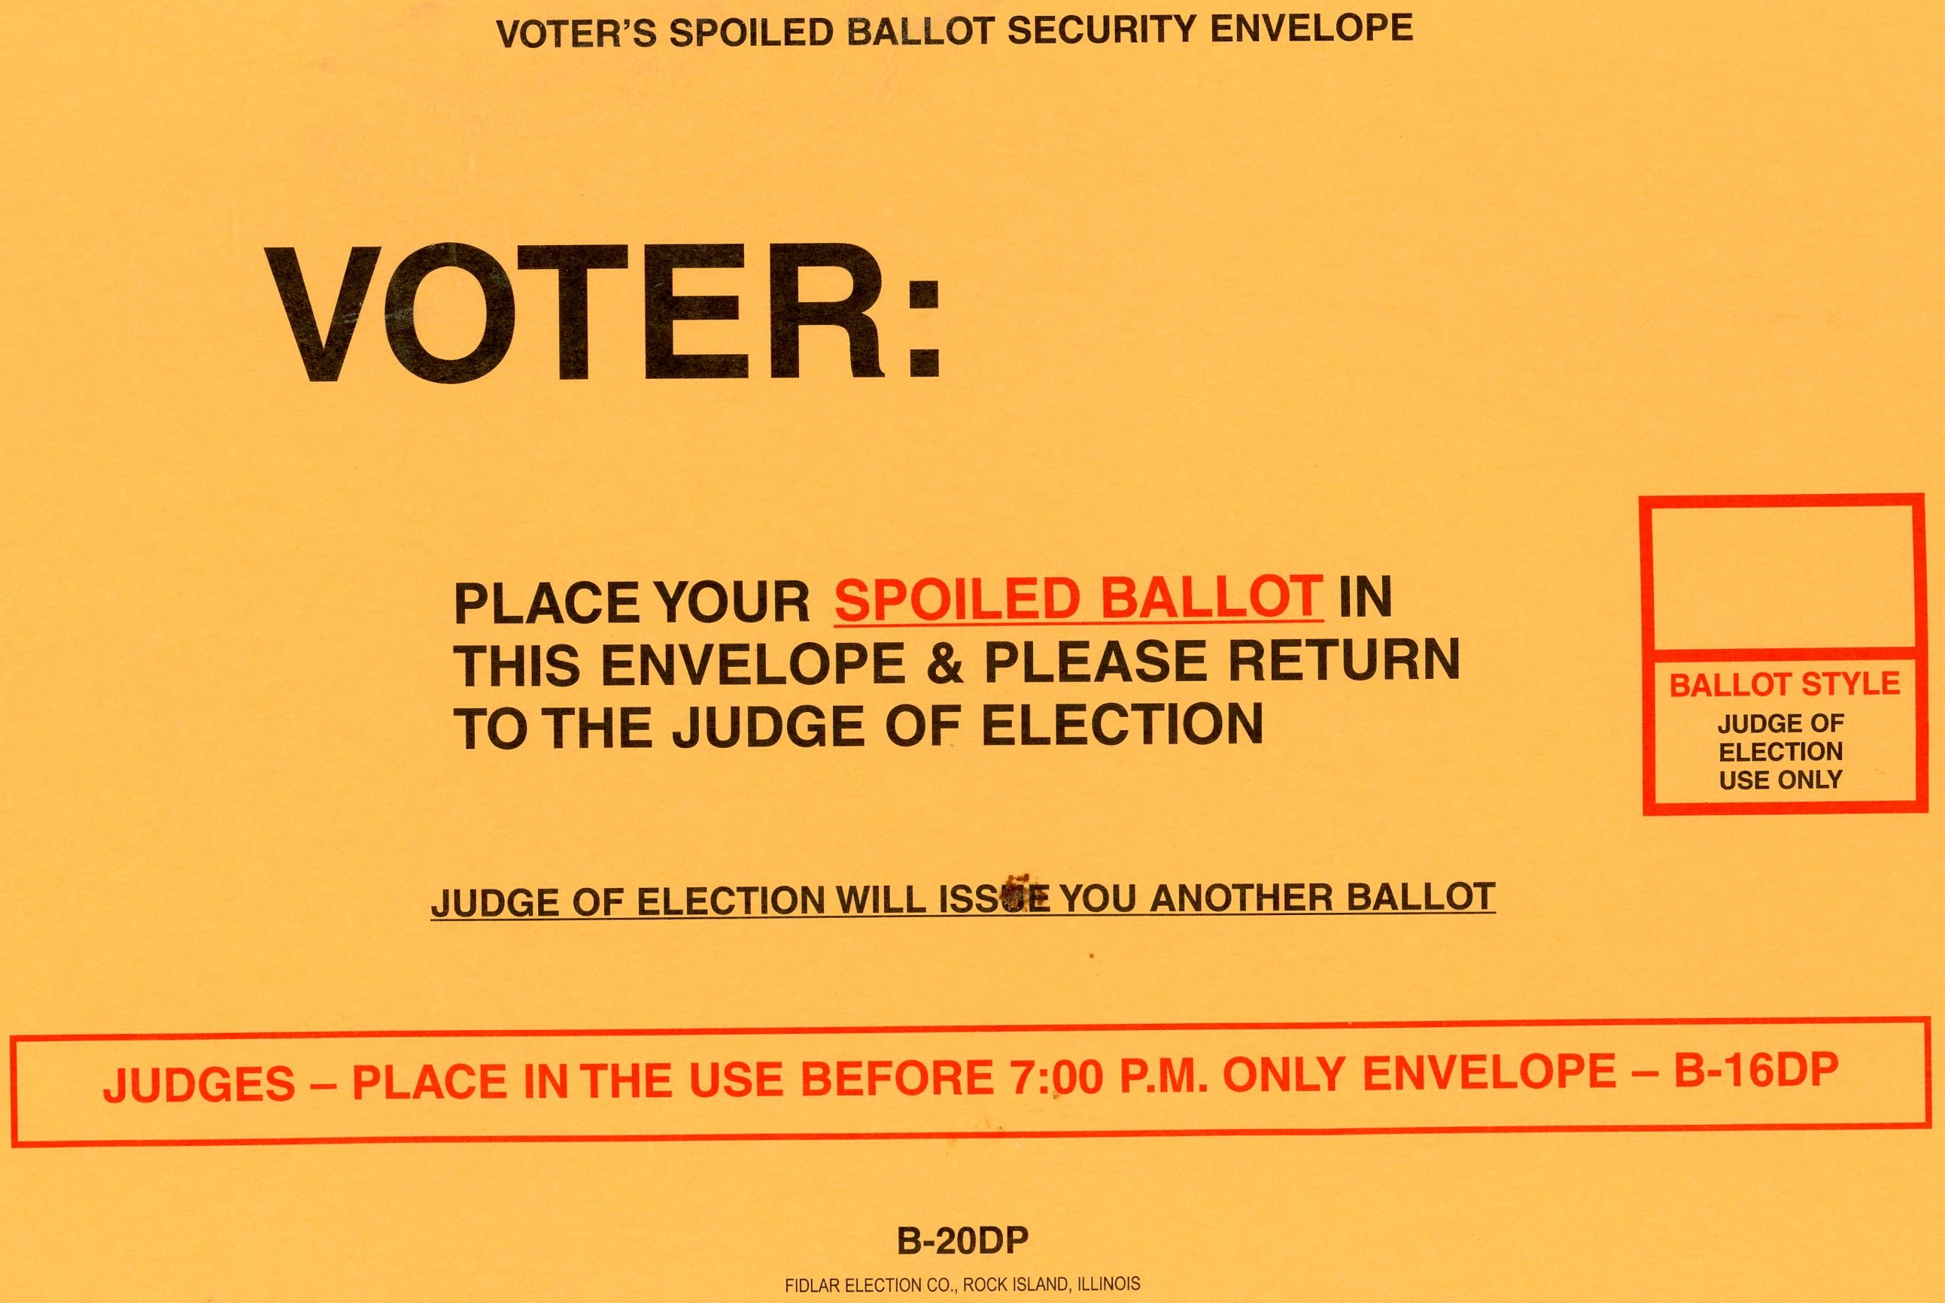
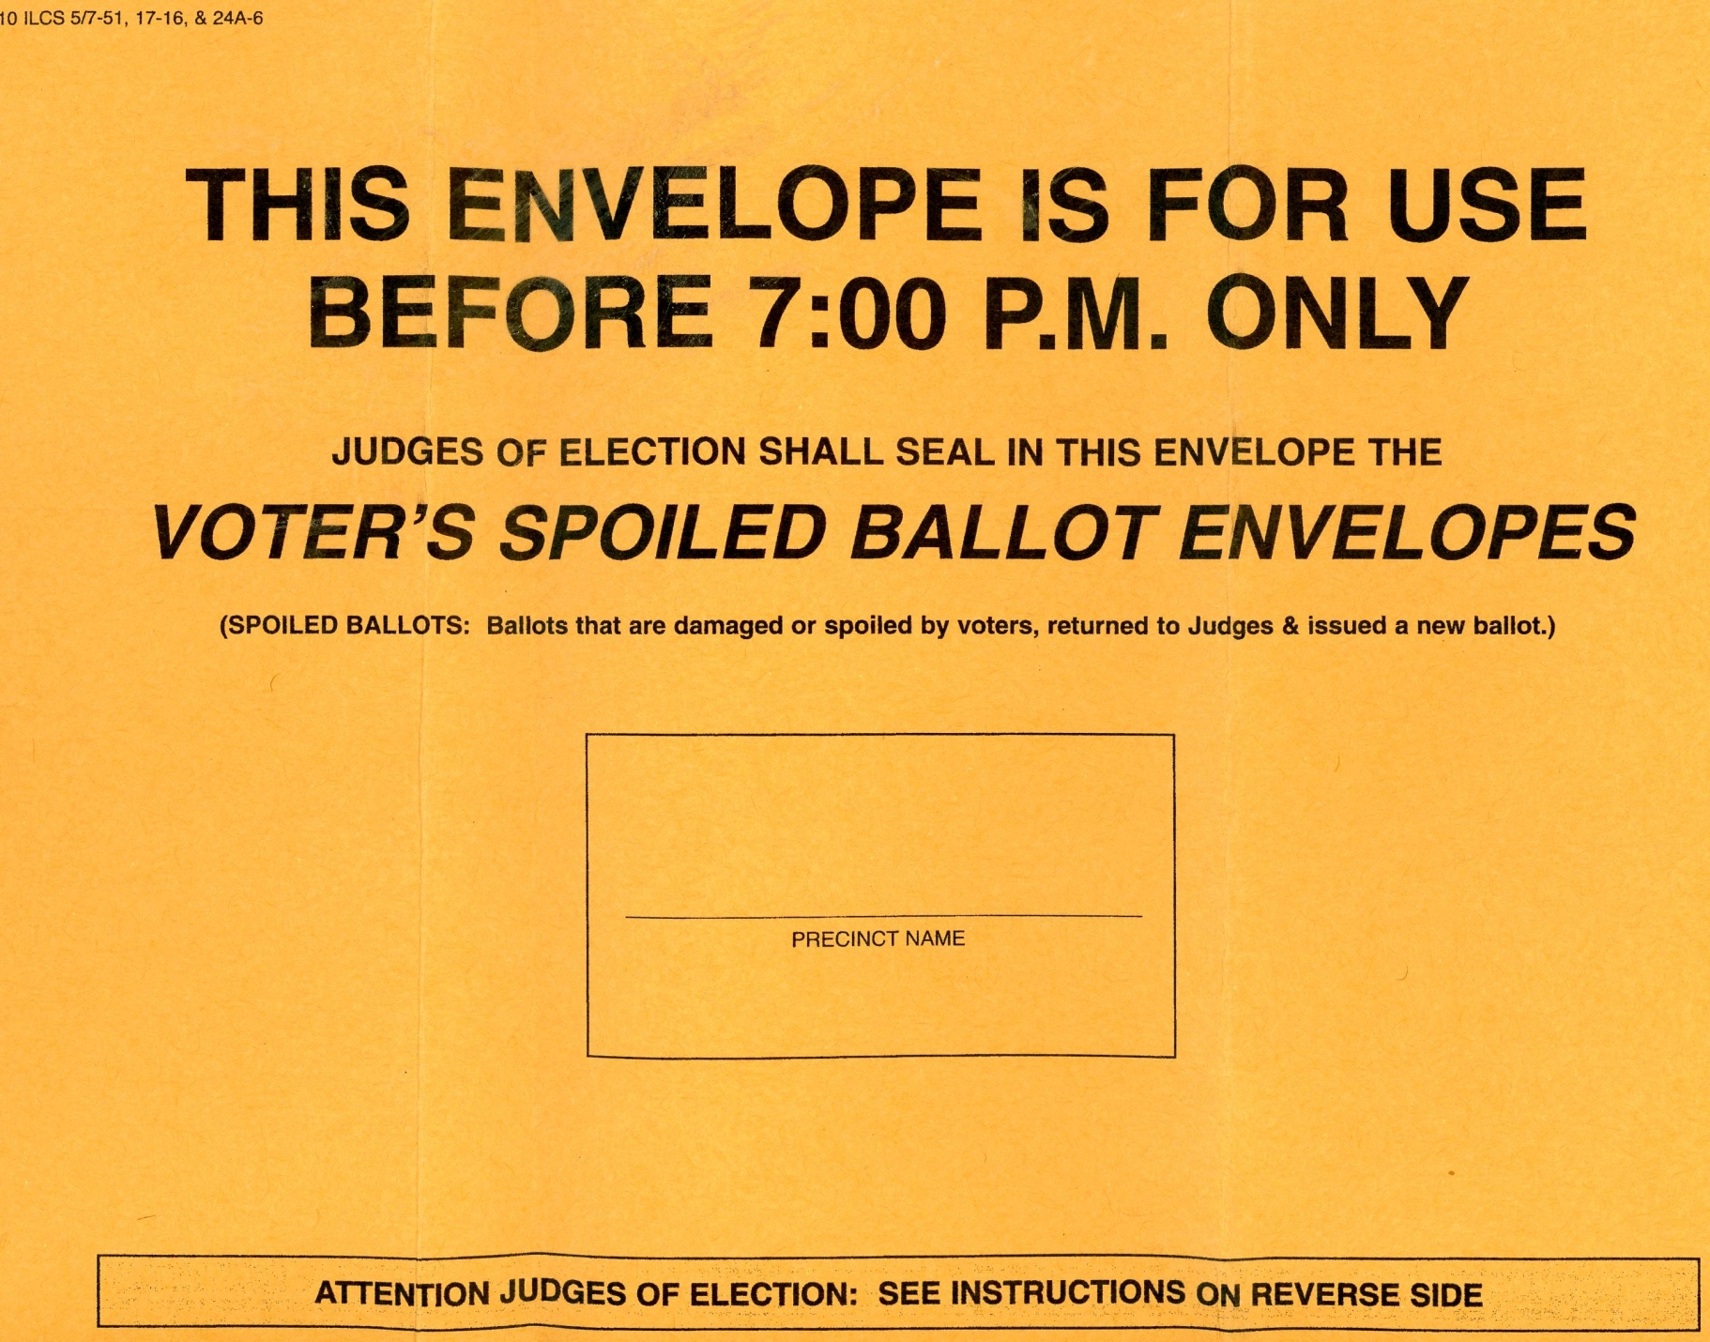
Voter places ballot in this envelope and seals envelope.
Election judge puts voter envelope into above envelope.
Notes:
Some jurisdictions have separate envelopes for each spoiled ballot (top example). The voter just needs to put their spoiled ballot into the envelope and seal it. It is important for the election judge to mark the ballot style on the outside of the envelope, in order to be able to balance the “Statement of Ballots” form after the polls close.
All individual spoiled ballot envelopes will then be placed and returned together in the larger “spoiled ballot envelope”

Slide 52
Place all spoiled ballots in this envelope together.
Notes:
Some jurisdictions do NOT have separate envelopes for each spoiled ballot. In those situations, all spoiled ballots will be placed together in the “spoiled ballot envelope”.

Slide 53
Provisional Voting? Call your Election Authority!
Why do we have provisional voting?
Reduces confrontation
Corrects mistakes in the registration process
Updates voter records
Judge’s have no record of registration and they refuse to register
Voter did not provide ID when registering by mail and cannot provide it on election day
Voter’s voting status has been challenged
Voter’s name appears on list of people voting early
When should you use provisional voting?
Notes:
If it was determined at the first station that the voter is only eligible for a provisional ballot, contact the election authority to determine the provisional voter’s correct precinct, then follow the procedures. (10 ILCS 5/18A)
The voter now has seven calendar days after the election to follow up with the election authority to prove that they were eligible to vote.
The election authority then has up until 14 days after the election to decide if these provisional ballots are to be processed or not.

Slide 54
Provisional Voting Procedures
Verify voter name and address
Fill out application to vote
Fill out Provisional Voter Affidavit
Mark why voter was given a provisional ballot
Issue voter the provisional ballot and envelope
Deposit ballot and envelope in separate securable container
Notes:
Ballots may now partially be counted if cast in the wrong precinct. (10 ILCS 5/18A)

Slide 55
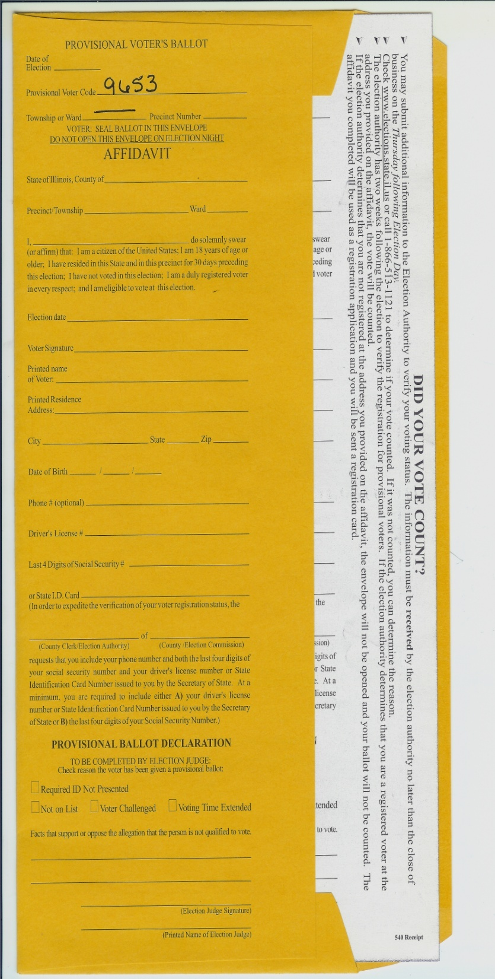
Provisional Voter Affidavit
Voter and election judge both have sections to fill out on this affidavit.
Voter is given ballot and envelope, and directed to come back to judges table after voting.
Voter seals ballot in envelope before giving it back to the judges.
Judges issue “white receipt” to voter to follow-up after election day.
Put envelope in “separate securable container” and return to counting center after polls close.
Notes:
There are different provisional supplies that are distributed by different vendors.
-One company’s provisional supplies consist of a brown envelope with a white carbon inside.
-One company’s provisional supplies consist of two white envelopes with a white affidavit(with two carbons).
First the “Provisional Voter Affidavit” is filled out. The voter and election judge both have sections to complete.
The voter will be given their correct ballot sheet and sent to a voting booth to mark their ballot. After voting their ballot, the voter will then seal it inside the yellow envelope. The voter will then hand the envelope (with ballot sheet enclosed) back to the election judge.
The election judge issues a numbered “white receipt” to the provisional voter (this is the white carbon that started out inside the yellow envelope). This allows the voter to follow up after the election to find out if their ballot was counted.
The election judge then places this provisional ballot in a “separate securable container” to return it to the counting station after the polls are closed.
Many jurisdictions have the election judges keep EVERYTHING for this provisional voter together. Their application to vote, their provisional voter affidavit, and their provisional ballot – that has been sealed in an envelope.
If the provisional voter’s application and affidavit were spindled, the numbers would be off the next time the election judges “track their numbers”. The spindled applications should only equal the number of voters that have truly cast a ballot into the tabulator or ballot box on election day.

Slide 56
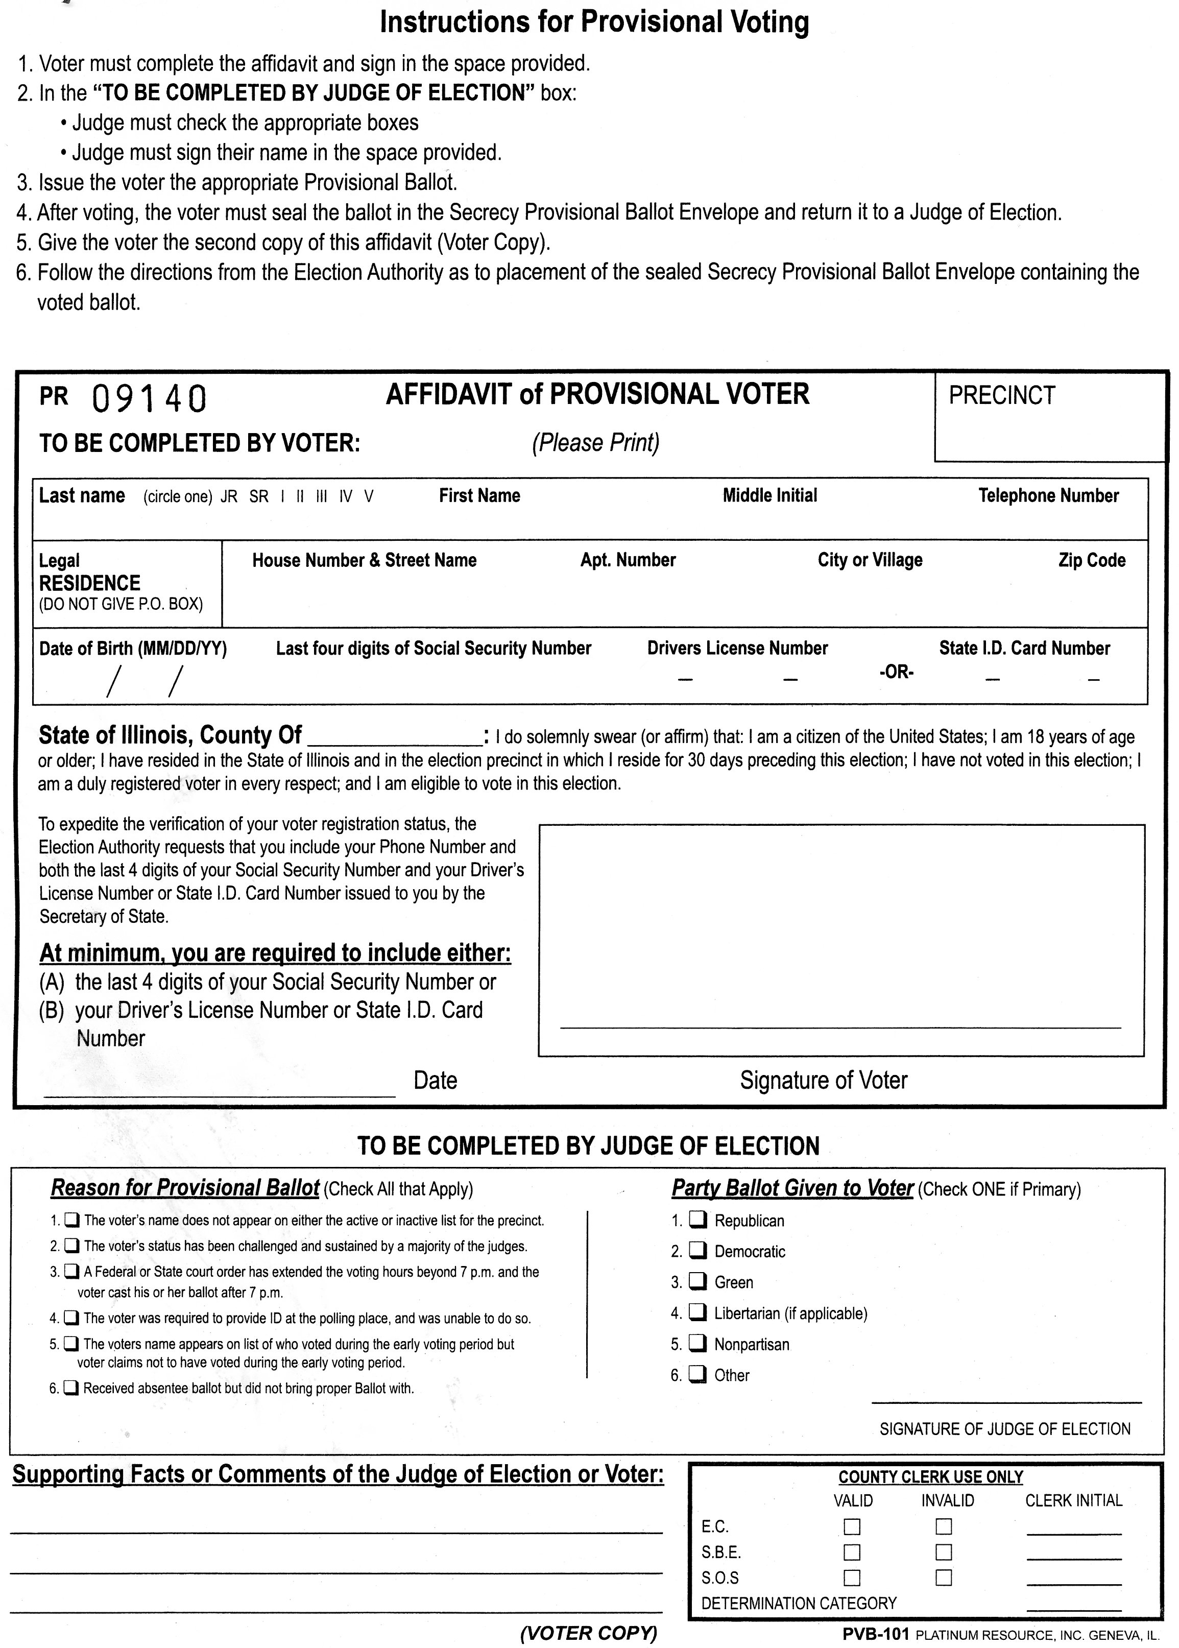
Provisional Voter Affidavit
Voter and election judge both have sections to fill out on the affidavit.
Election judge keeps this sheet while the voter votes the ballot.
There is a yellow carbon copy behind this sheet for the voter after they vote.
Notes:
There are different provisional supplies that are distributed by different vendors.
-One company’s provisional supplies consist of a brown envelope with a white carbon inside.
-One company’s provisional supplies consist of two white envelopes with a white affidavit (with two carbons).
First the white “Provisional Voter Affidavit” is filled out.
The voter and election judge both have sections to complete. Push hard when filling out this form because there are two carbon copies.
After this numbered affidavit is filled out, the election judge should remove the back yellow copy that will be handed to the provisional voter after they vote.

Slide 57
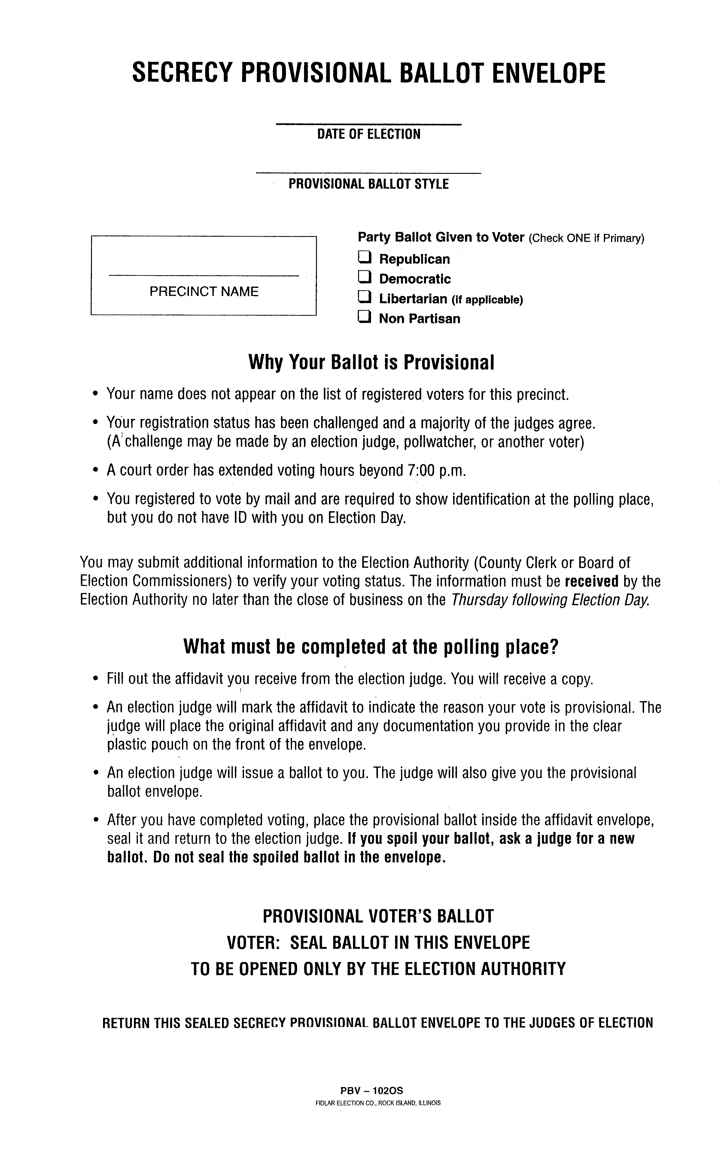
Secrecy Envelope
Voter takes this into the voting booth with them.
Voter inserts their completed ballot into this envelope and seals it before leaving the booth.
Notes:
The voter will be given their correct ballot sheet and sent to a voting booth to mark their ballot. After voting their ballot, they will then seal it in their “white” provisional ballot envelope. They will hand the envelope (with ballot sheet enclosed) back to the election judge.

Slide 58
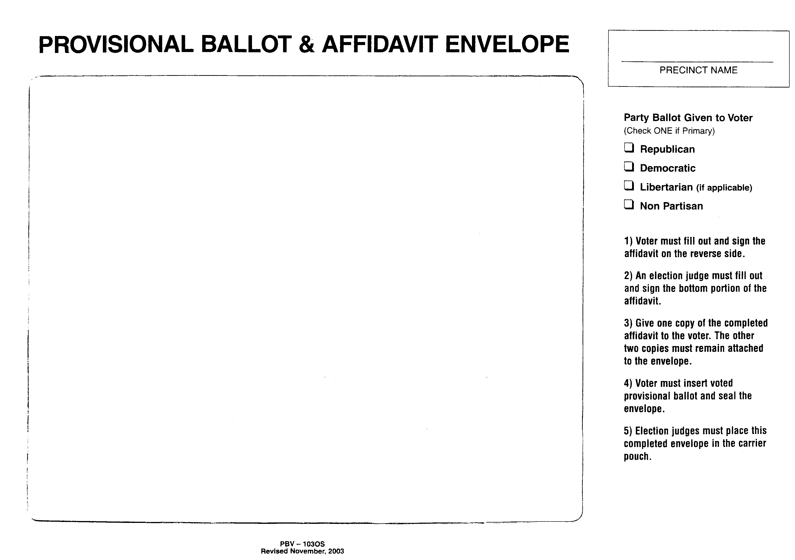
Ballot & Affidavit Envelope
Affidavit should show through the window of the envelope.
Insert the sealed Provisional Ballot Envelope behind the affidavit.
Give the voter the yellow Provisional Ballot receipt.
Return to the counting center in a separate sealable container.
Notes:
The election judge issues the “yellow numbered receipt” (copy of affidavit) to the provisional voter. This allows the voter to follow up after the election to find out if their ballot was counted.
The election judge then places this provisional ballot envelope, provisional voter affidavit, and the voter’s application in this “Provisional Ballot & Affidavit Envelope”.
(Some jurisdictions no longer use this envelope. If not, this slide can be deleted.)

Slide 59
Provisional Ballots
DO NOT
Go into the Tabulator!
Notes:
A provisional ballot NEVER goes into the tabulator. It must be placed into a “separate securable container”. It will not be tabulated until AFTER election day, and not until after the voter’s records have been verified and the problem resolved.

Slide 60
Verify the number of applications = the number of ballots cast!
Track
Your
Numbers!
Check your numbers every hour. If you are “in balance” every hour, you will be “in balance” when the polls close!
Notes:
It is a very good idea to “track your numbers”. Every hour throughout the day, just verify that the same number of voters that have filled out an application….are the same number of voters that have voted and cast their ballots. You can do this by checking the number of spindled applications against the number of ballots cast on the tabulator(s).

Slide 61
Judge’s Station #4 – Ballot Box Judge
Checks ballot for judge’s initials
Voter inserts ballot into the tabulator
Check voting booths
Notes:
Station Four: Extra secrecy sleeve covers should be kept at this station.
-The ballot box judge must check that the ballot sheet has the proper judges initials.
-The voter will then carefully insert the ballot sheet into the tabulator by allowing it to be pulled from the secrecy sleeve/envelope into the tabulator. Under no circumstances should a judge remove the ballot sheet from the secrecy sleeve. This could violate the secrecy of the ballot.
-The ballot box judges should periodically check the voting booths and voting devices during the day to make sure that they are free of campaign literature.
-Make sure that no one interferes with the voter while voting.
-It is important that all election judges smile and remain calm at all times.

Slide 62
Over/Under Voted Ballot
The machine will identify the ballot.
Voter can either spoil that ballot and request a new one, cast the ballot “as-is”, or return to the voting booth and add votes to the SAME ballot.

Slide 63
Auxiliary/Emergency Bin
Voting should never stop!
Use emergency bin for ballots when machine isn’t working property
AFTER polls close, insert these ballots into tabulator
Notes:
If the power goes out or there is an issue with the tabulator, contact the Election Authority immediately so they can send out the proper help.

Slide 64
Notify election authority the day before
Two election judges (one from each party)
Complete the process as if voter was in polling place:
  Voter completes application
  Judges do the verification
  Two judges deliver the ballot out with secrecy sleeve
  Voter will vote in secrecy
  Two judges will bring the ballot back inside and insert it into tabulator
  Notify voter when complete
Curbside Voting
Notes:
Curbside voting is where voting is completed outside the polling place, usually along the curb to the building. The guidelines state that when a voter requests curbside voting, they must make the request in writing no later than the day before the election. The election authority will then notify the election judges of the voters who are eligible for this service. Two judges, one from each political party, will handle this process. Curbside voting can occur no more than 50 feet from the entrance to the polling place. The voter must first complete the application, and then the judges will take the application back into the polling place to do the signature verification. Once the verification process is complete, the two judges will deliver the initialed ballot back outside to the voter, along with a ballot privacy cover. The voter will mark the ballot in secret. Then the two judges will carry the ballot (inside the privacy cover) back into the polling place and insert it into the ballot box/tabulator. After the ballot drops down into the ballot box, the election judges need to go back out to the curbside voter and explain that their voting is complete, and that they are free to leave.

Slide 65
Counties can elect to establish curbside voting for any individuals who would like to utilize it during early voting or on election day
2 election judges from opposite parties must be designated to each vehicle
Individuals must be allowed to mark their ballots without interference.
Curbside Voting
Notes:
(10 ILCS 5/17-13.5)

Slide 66
At 6:30 PM…
Announce the polls will close in one-half hour.
Don’t forget to vote if you are in your voting precinct!
Notes:
At 6:30 P.M. announce in a loud clear voice that the polls will close in one half hour. This may need to be repeated to make sure that all of the voters hear the announcement. (10 ILCS 5/17-2)
Always remember to vote! If you are serving as an election judge in a precinct other than your own, remember to vote early or vote by mail prior to election day.

Slide 67
At 7:00 PM…
Announce out loud “Polls are Closed!”
All voters in line at 7:00 PM are allowed to vote
Close and lock door
Remove polling place signs
Notes:
-Promptly at 7:00pm announce that the polls are closed.
-Only the voters who are waiting in line as of 7:00pm (either inside or outside the polling place) should be permitted to vote. At 7:00pm, get all voters inside the building, if possible.
-Close and lock the door.
-Remove the Polling Place sign.
If all voters in line at 7:00pm will not fit inside the building, one of the election judges should stand at the end of the line to make sure that no one else gets in line. Everyone that is in line at 7:00pm will be permitted to vote…even if it takes two hours to finish processing the voters!

Slide 68
After the Polls Close:

Slide 69
Who is Authorized to Remain in the Polls?
Representatives of:
  State Board of Elections
  Attorney General
  State’s Attorney
  Election Authority
Election Judges
Pollwatchers
Law Enforcement Officials

Slide 70
Check the Auxiliary/Emergency Bin
Before closing out the machine:
Remove ballots from emergency bin
Insert ballots into tabulator

Slide 71
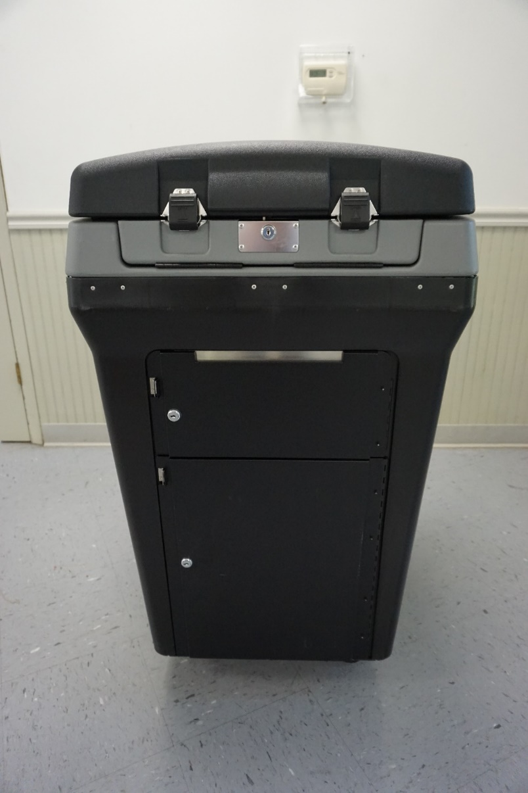
DS200 Tabulator Shutdown

Slide 72
Instructions will be provided to you!

Slide 73

Press the “Close Polls” button next to the locked compartment by the screen.
Hit “Close Polls” on the screen.

Slide 74
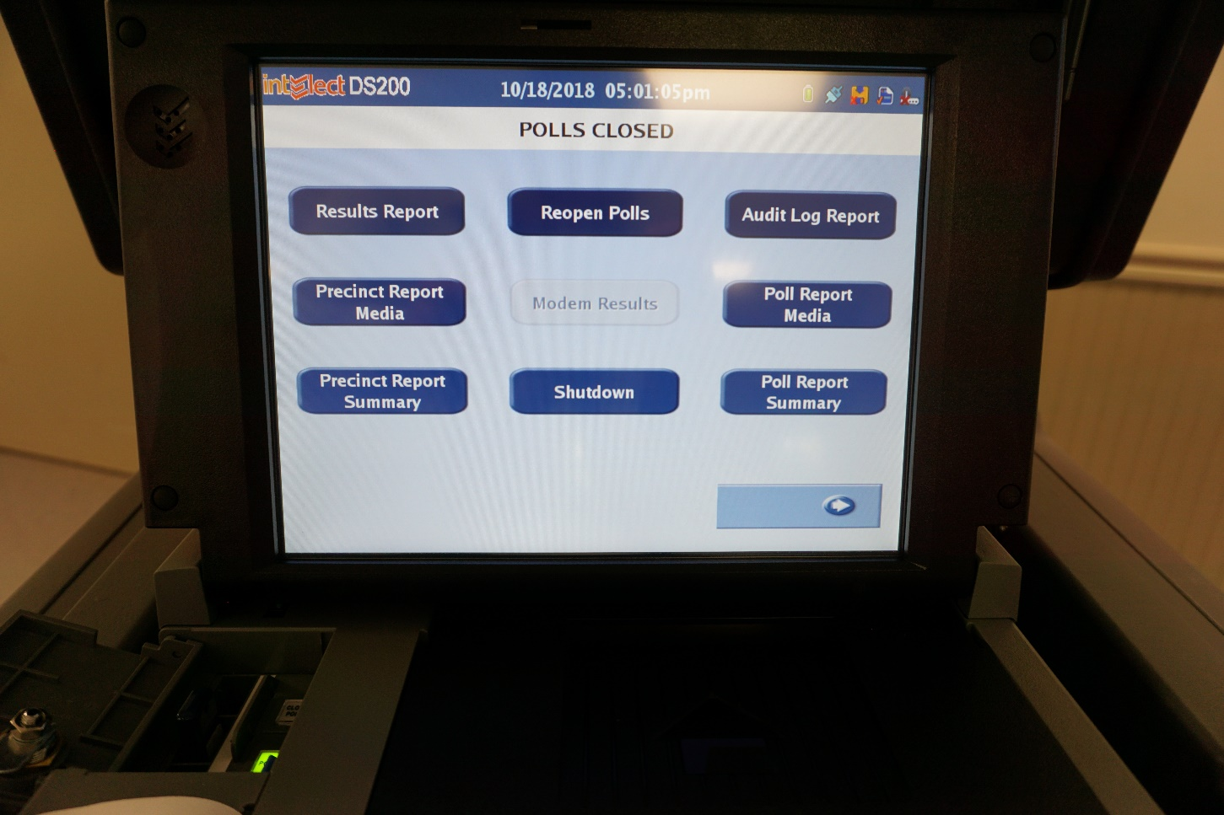
Press “Results Report”
Print as many copies as requested
Print copies for pollwatchers if requested
Notes:
Note: the judges may not have to press “results report” to print tapes for their county IF the election authority has already set up the machine to print the required number of tape copies.

Slide 75
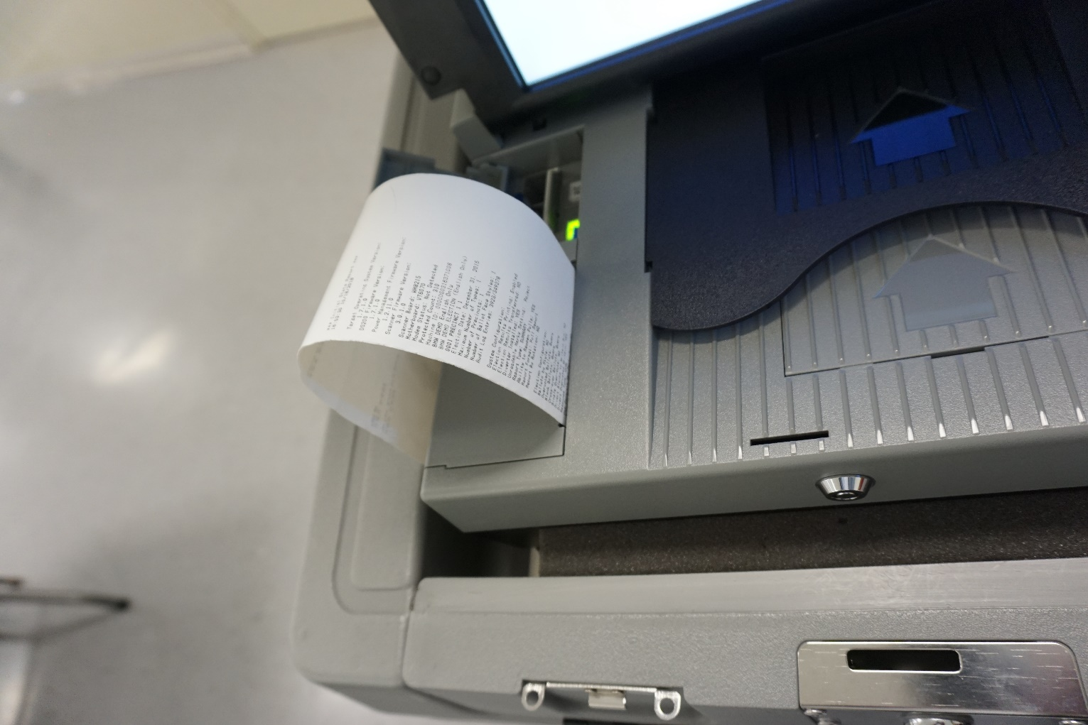
All judges must sign each tape!

Slide 76
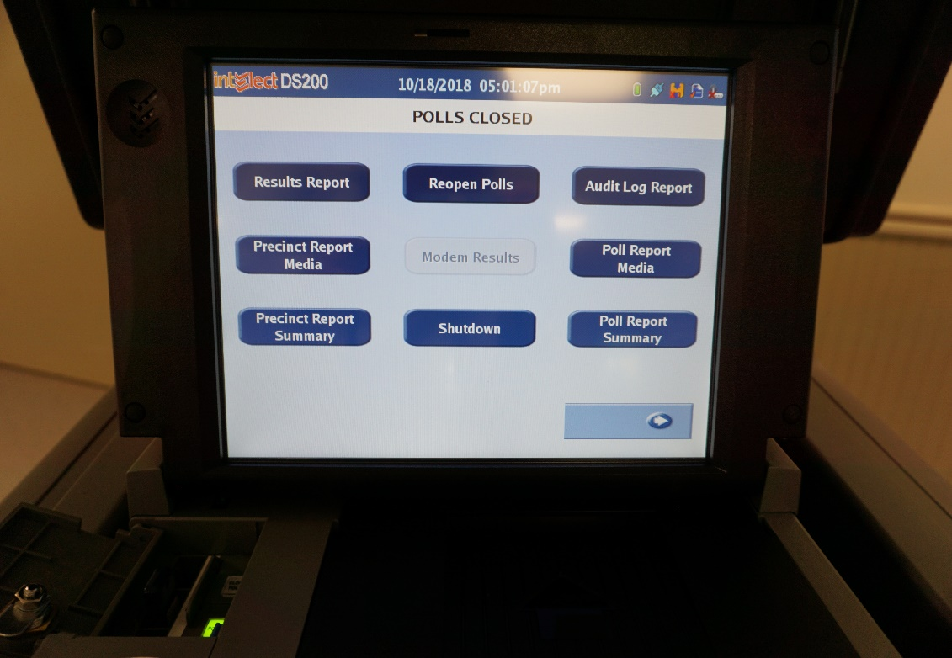
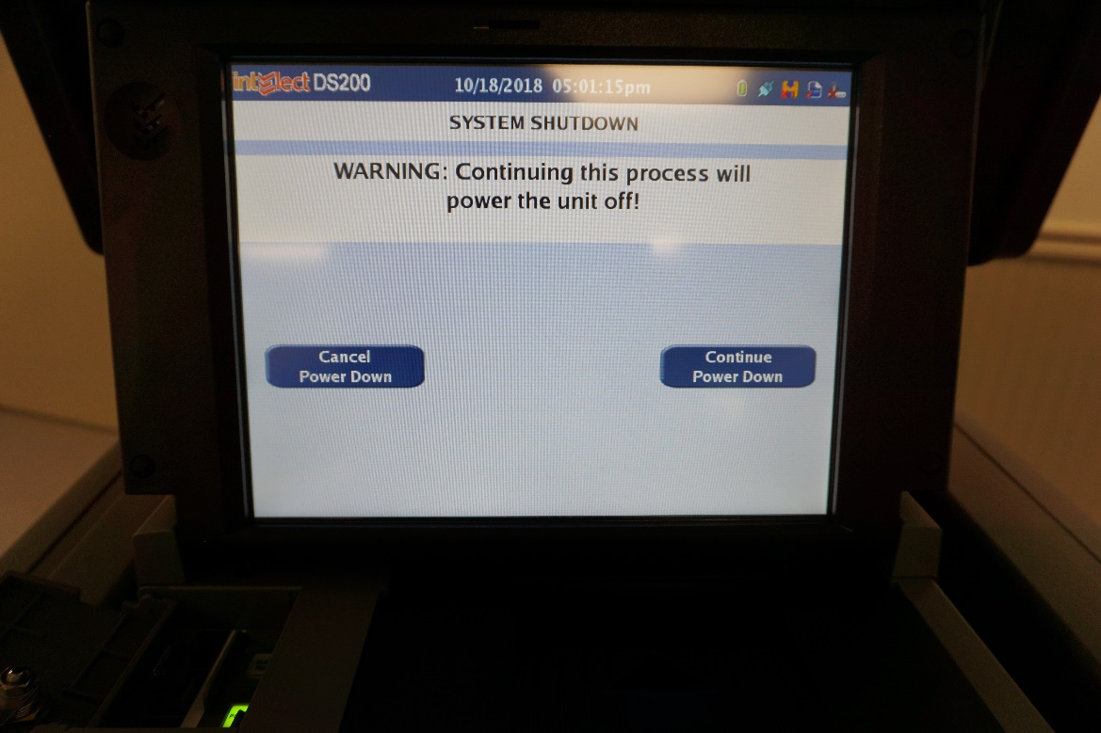
Press the “Shutdown” button and “Continue”

Slide 77
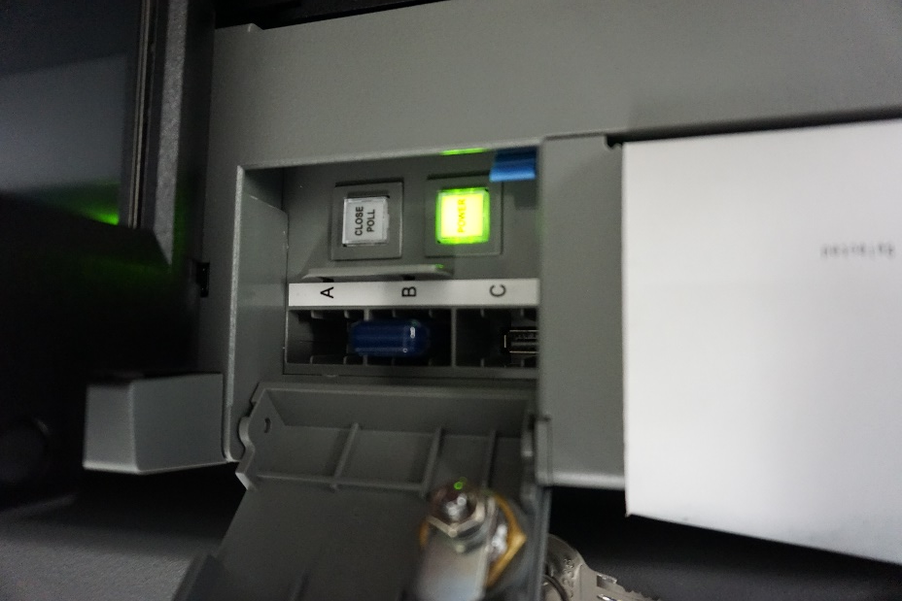
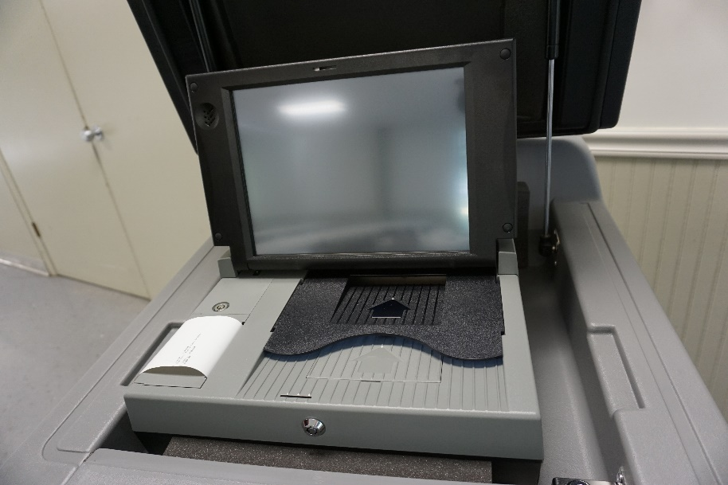
Follow your Election Authority’s instructions!
Remove memory stick and return to counting center.
Unlock entire tabulator and return to counting center.

Slide 78
Express Vote Shutdown

Slide 79
Instructions will be provided to you!

Slide 80
Unlock power compartment
Turn machine off

Slide 81
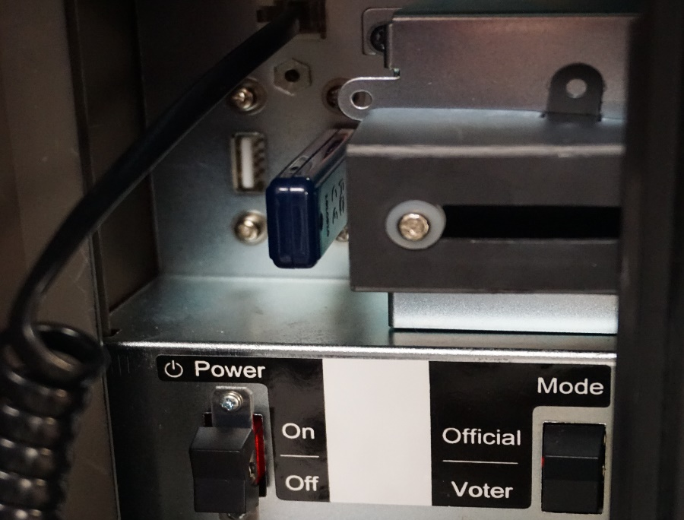
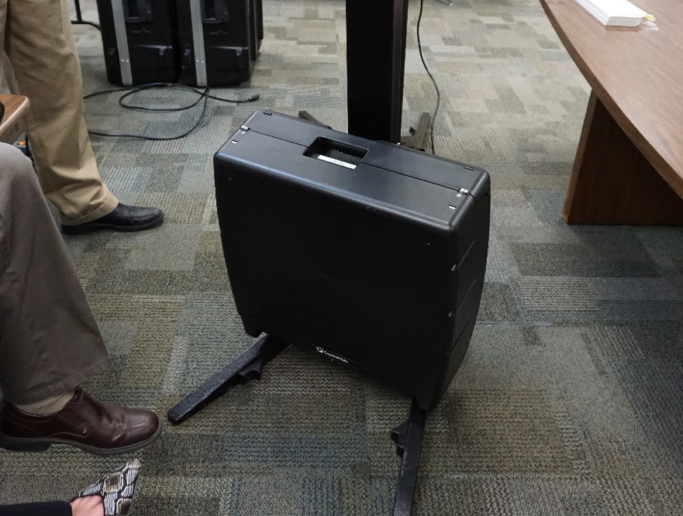
Follow your Election Authority’s instructions!
Remove memory stick and return to counting center.
Lock up entire machine and return to counting center.

Slide 82
Open the Ballot Box
Remove ballots from the tabulator
Compare number of ballots to number of applications
Process write-in votes
Notes:
Now – Open the Ballot Box. Remove the ballots from the tabulator/ballot box and group them according to precinct (if more than one precinct is using the same tabulator/ballot box), and according to ballot style. Carefully count the ballots in each group and compare the number with the number of applications for each ballot style. The number of ballots of each type must be the same as the number of applications for each ballot style. If the numbers do not agree, recount the ballots and check that the applications are numbered/spindled correctly.
Record the number of ballots and applications for the different ballot styles on the ballot record form. If you have more ballots than applications, refer to your manual for instructions on how to handle excess ballot sheets. If there are any excess ballot sheets, record this number on the ballot record form. As you separate the ballot sheets, check that each card is initialed and that there are no identifying marks. Also check each ballot for Write-in votes. If a write-in vote is found, place it aside to handle separately. Ballots which do not have the judges initials or which have an identifying mark must not be counted. Mark those ballots as “DEFECTIVE” and indicate the reason for which it is defective. All judges must sign the ballot sheet and place it in the “after 7:00pm envelope” for defective ballots.
*Note that not all election authorities use the same “statement of ballot” form. Some election authorities have the election judges spindle all applications on the same spindle, and do not have the election judges balance by ballot style. Always follow the instructions given by your own election authority. Explain that they need to be sure and to check the ballot box AND TABULATORS for ALL ballots that need to be returned.
**Also note that if any ballots are found to be defective, the election judges MUST contact the election authority immediately for instructions on retabulating the ballots.

Slide 83
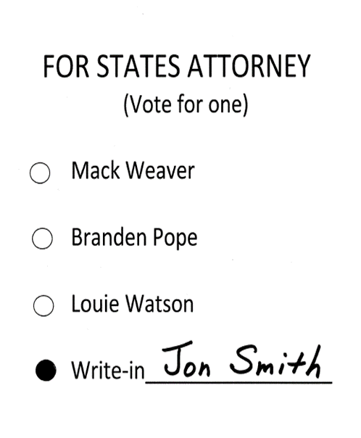
Processing Valid Write-In Votes
Must be on valid write-in sheet!
Determine the voter’s intent
Must be printed or written on ballot line
  No stamps
  No stickers
Oval must be darkened
Notes:
When counting write-in votes, it is the intent of the voter that counts. The spelling of a candidates name does not have to be exact as long as you can tell the voter’s intent. The name may be printed or written, but the use of stickers or stamps is prohibited. The oval in front of the write-in’s name must also be darkened in order to be counted.

Slide 84
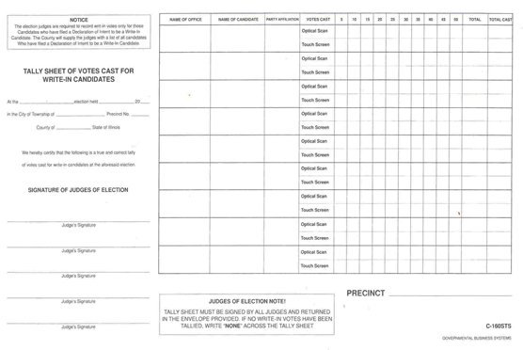

Tallying Valid Write-In Votes
NONE
If there is a valid write-in vote, tally it appropriately on this sheet.
If there are no write-in votes, write NONE across this sheet.
Notes:
If there is a write-in, determine if the write-in is valid. If the write-in is valid, record it on the tally sheet. After all of the valid write-in votes are tallied, sign the tally sheet. If no valid Write-in votes were cast, write “NONE” across the tally sheets and be sure to sign them.
If you are sharing a voting device with another precinct, be sure to record the write-in in the correct precinct.

Slide 85
Review checklist provided by your Election Authority and return proper materials
Tabulator Memory Card/Ballot Sheets/Tape
Touch Screen Memory Card/Canister/Tape
Envelope with Write-In Tally Sheets
Spindled Applications to Vote
Statement of Ballots
Signature Roster or Pollbooks
Voted Provisional Ballots
Completed Expense Sheets
Follow your Election Authority’s Instructions on Materials to Return!
Notes:
Update according to what the jurisdiction has requested to be added or taken away.

Slide 86
Complete and sign all forms
Leave your polling place clean and tidy
Notes:
Nothing is to be thrown away. Complete and sign all the required forms and envelopes Two “eligible” judges, one from each of the parties, must deliver the supplies directly to the counting center. Once you obtain a receipt, your job is complete.
(PA 96-1003 states that after the polls close on Election Day, only the judges eligible to vote in that jurisdiction may return election results and supplies to the counting center. This law specifically does not allow return of supplies by high school students or college students serving as election judges…if they are not eligible to vote in that jurisdiction.)

Slide 87
Returning Materials
Two eligible judges, one from each political party, will deliver the materials DIRECTLY to the Election Authority’s office when everything is done so the EA can close out the election.
Notes:
(PA 96-1003 states that after the polls close on Election Day, only the judges eligible to vote in that jurisdiction may return election results and supplies to the counting center. This law specifically does not allow return of supplies by high school students or college students serving as election judges…if they are not eligible to vote in that jurisdiction.)

Slide 88

Your Election Authority certifies the official election results!
Missing Vote by Mail ballots
Missing Early Vote counts
Missing possible Provisional Ballot counts
Notes:
Please remember that all your precinct results are “unofficial”! There are several pieces to this puzzle:
-Election Day in-precinct ballots
-Centrally counted ballots (vote by mail, early and grace period ballots)
-Provisional ballots – yet to be decided
-Vote by mail ballots – yet to arrive, but postmarked on time
The election results are not official until the “canvass” has been completed. This can take up until 21 days after the election, and is done by the election authority.

